Slide 1
UNILAC timing essentials
UNILAC has to be operated at 50 Hz without any interruptions in any of the following (not exhaustive)
  (ex)change of schedule/pattern
  change of chain events, e.g. time of event or addition/removal of events ⇒ switch between static event sets
  data supply to devices ⇒ single device: continue operation; large sections: cont. op. w/o beam
Synchronised wrt. power grid 50 Hz
Online actions (not exhaustive):
  Profile grid guard: reduce beam pulse length and execution rate with beam for all chains affected on operators request
  Change beam pulse length on operators request
  Interlock: execute affected chains w/o beam on request

Slide 2
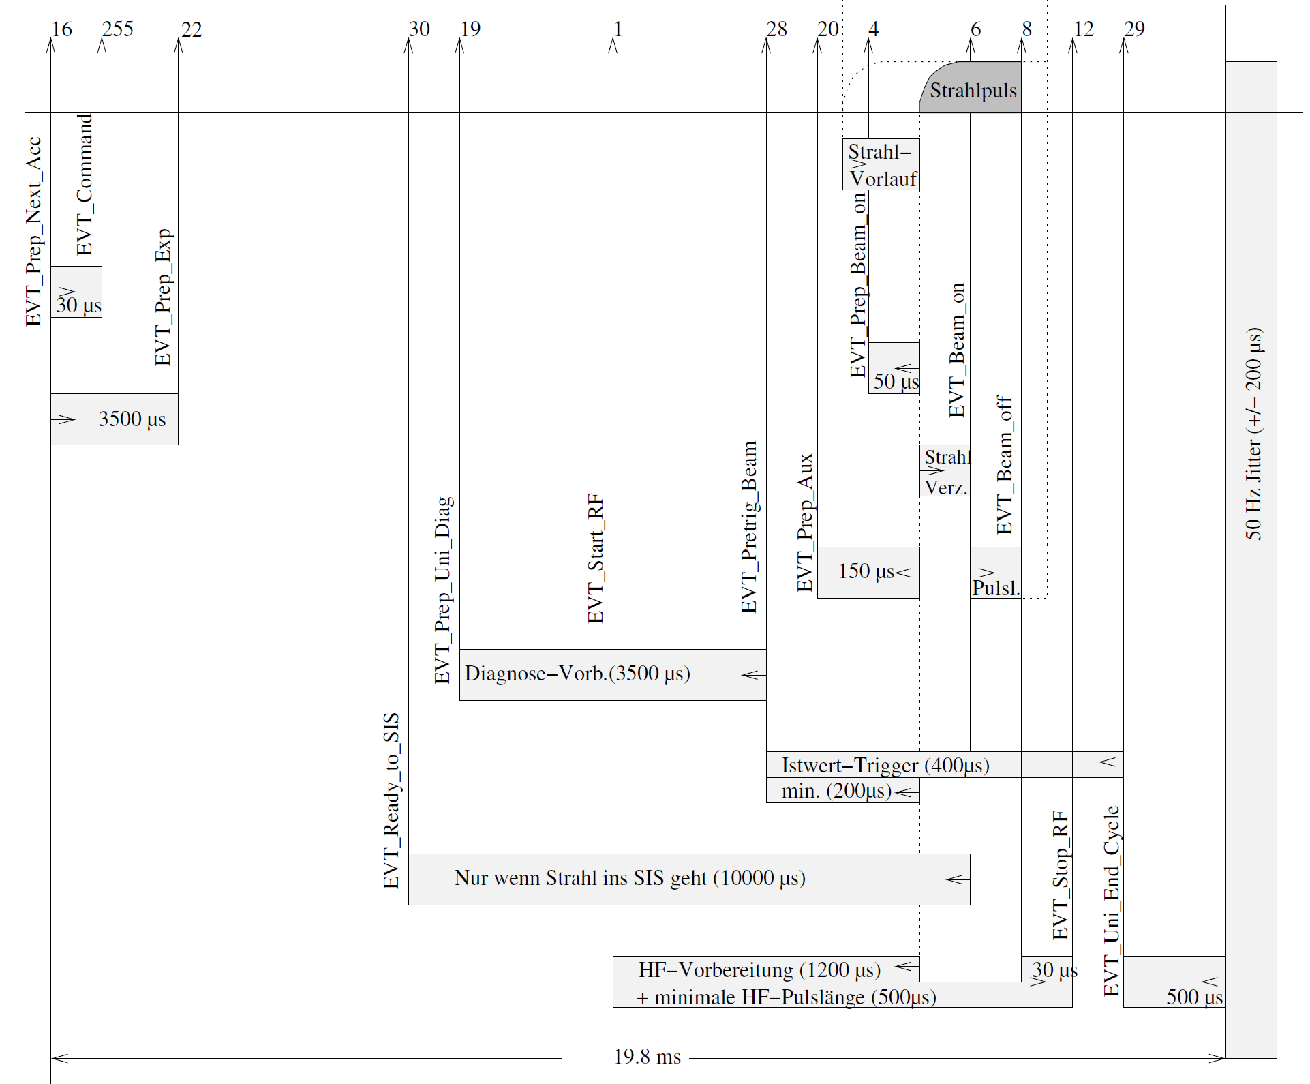
2 principle UNILAC event sequences: Fix – except pulse lengths
Operating parameters (pulse lengths)
Connection source-accelerator timing
(ion beam pulse start & stop at source)
Cycle length (20 ms)
Connection to absolute time
Sources
Accelerator

Slide 3
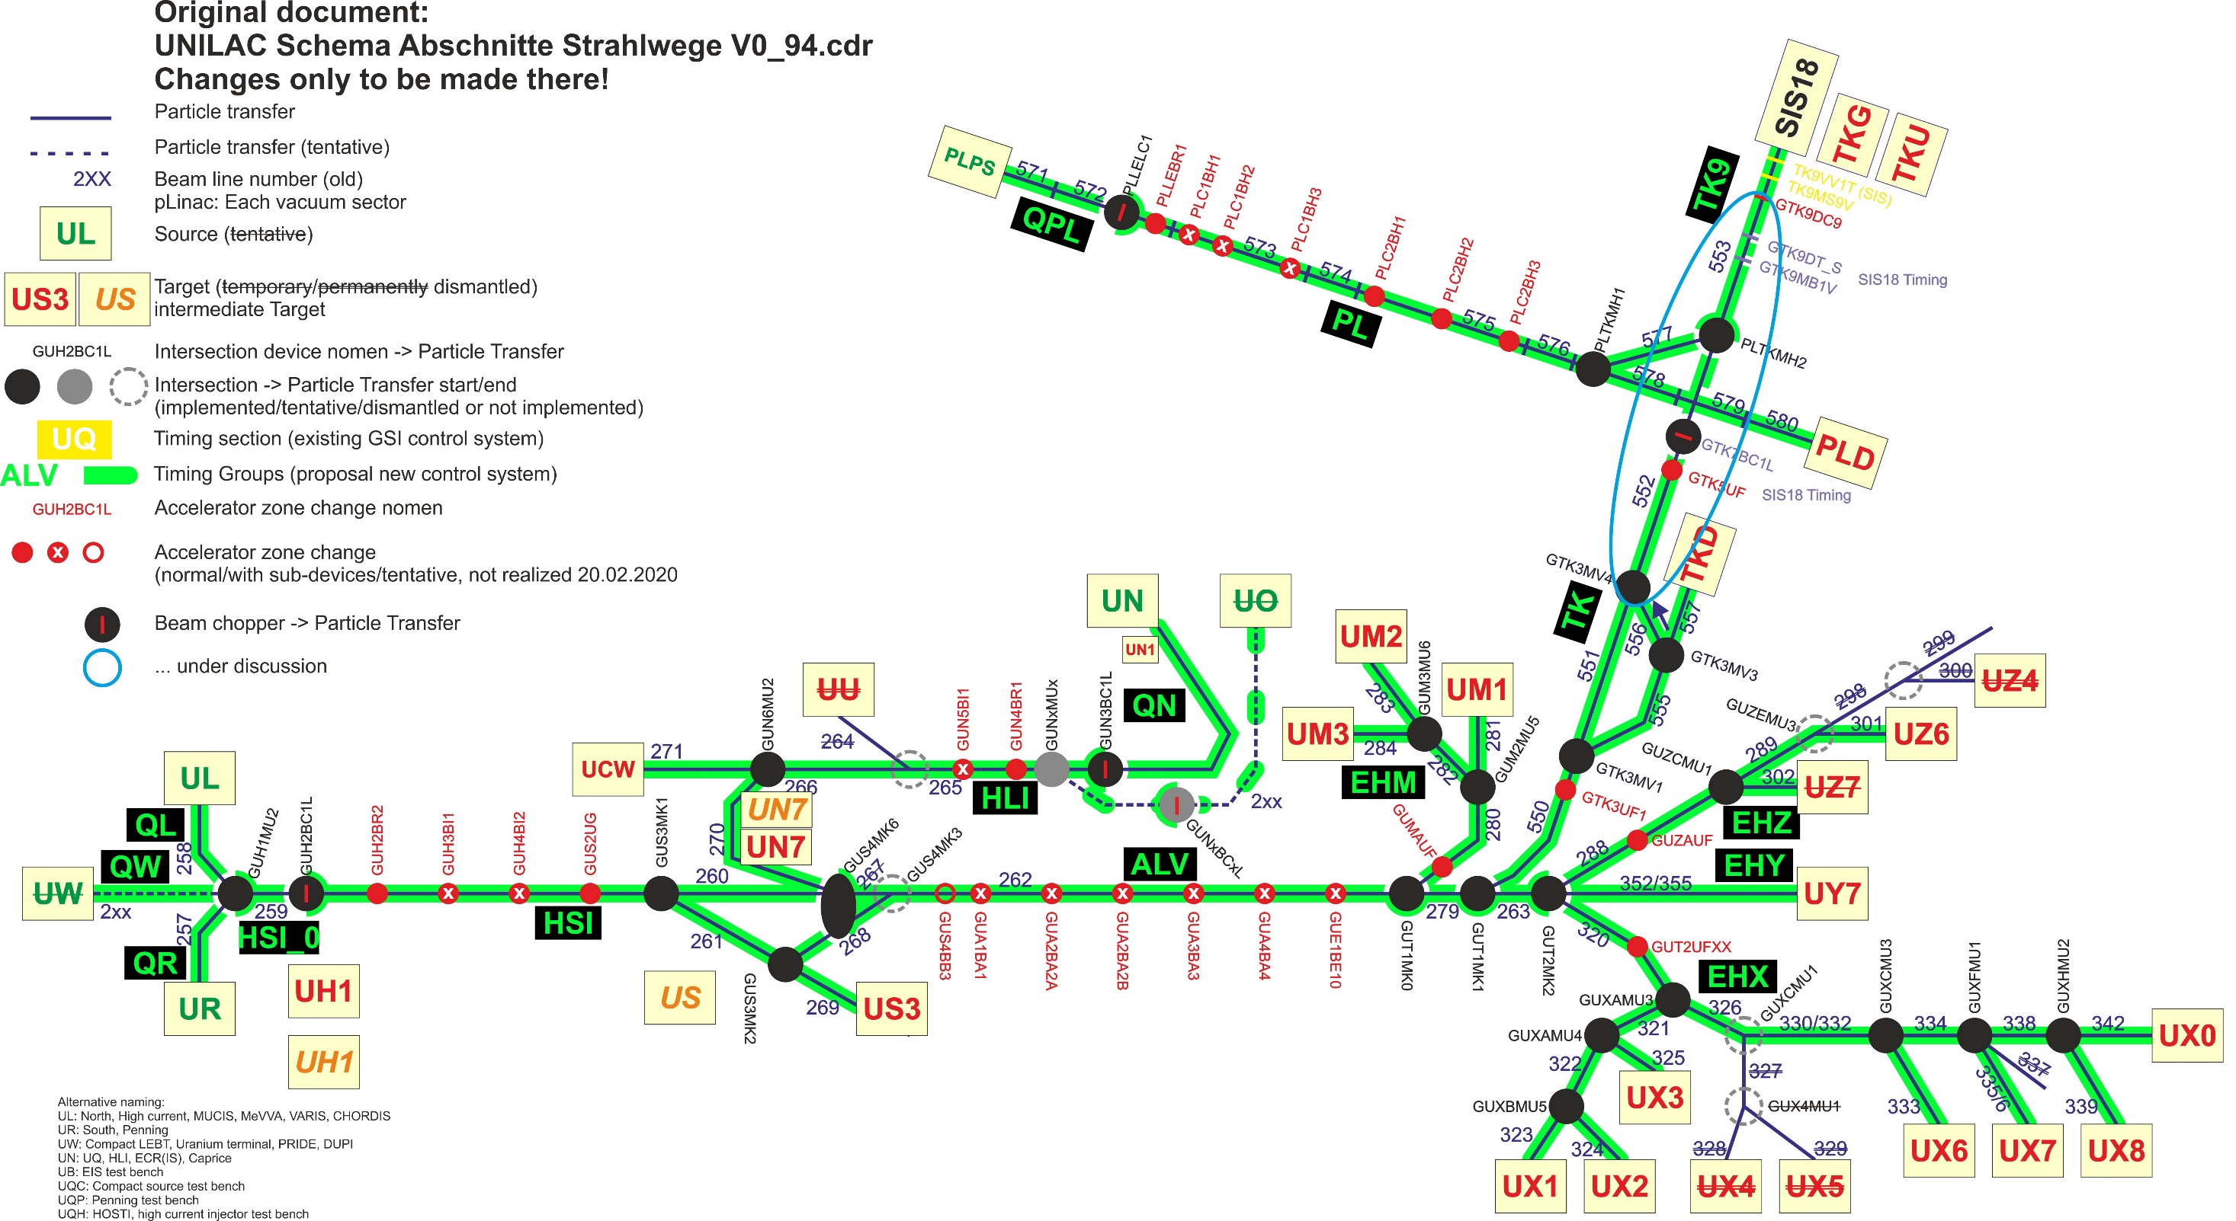

Slide 4
New UNILAC timing basics (draft proposal)
Preplanned schedules:
  based on SIS18 beam requirements and source availabilities ⇒ length equals SIS18/FAIR-pattern (~1s to 100s of seconds?), UNILAC may require certain length of SIS18/FAIR-pattern
  filled in with UNILAC users, UNILAC machine needs added
  run periodically by DM, 50*n chains per second
  one schedule per SIS18/FAIR-pattern, extra schedule for rarely executed FAIR chains, plus UNILAC standalone schedule, and others?
  switch between schedules at starting point without interruption of 50 Hz operation
  contains chain indices (pointers, wrappers), hundreds of executions of several chains in one schedule
Standalone chains:
  single chain identity may be executed multiple times in one schedule and used in several schedules
  set of at least 16 chains available in timing system, any subset may be used in any schedule
  chains may be executed simultaneously in arbitrary combinations (only one chain per timing group)
  changes applied to a chain have to take effect for all future executions at one point in time
  persistentidentification chain ⇔ virtual accelerator, over different schedules
  one single UNILAC chain may be combined (“gekoppelt”) with several SIS18 chains
Event sequence, execution:
  All UNILAC chains share similar, short event sequences of fixed length; two principle event sequences: 1) sources & LEBT; 2) all other timing groups after chopper
  only two or three event sequences needed per chain
  beam processes and events of one chain run in parallel in all timing groups ⇒ bursts of events at specific times
  changes to the event sequence of one chain have to take effect in all timing groups simultaneously
  generate several versions of event sequence in advance or on-the-fly: standard, shortened beam pulse, no beam pulse
  change beam pulse length: generate new standard event sequence, send to DM, reset pointer/wrapper
Timing groups:
  ~45 timing groups (~14 would be sufficient)
  all timing groups of one chain share the same event sequences (except source & LEBT and end of TK)
  provide MIL-timing derived from adequate timing group

Slide 5
Example schedule
Schedule
FAIR-Pattern

Slide 6
Merge beam processes, insert abstraction layer
Merge beam process nodes to one BPC node
  Contains all timing messages, hence all information for one beam production chain
Hide BPC nodes by static wrappers
  Contain only pointer to BPC node
  Many pointers in supercycle direct to static wrapper
  ⇒ pointers and supercycle not affected by BPC exchange
Supercycle and wrappers contain only BPC index
Exchange of beam process
  Generate one new node with new version of BPC timing messages
  Change one pointer from wrapper to this node

Slide 7
Supercycle execution
Single supercycle
Multithreaded, one worker thread per BPC
  Branch to BPC node if index in cycle
  Generate timing messages for BPC
  Callback
  Go to next supercycle node
Synchronization mechanism available
Arbitration mechanism available
  thread with nearest event gets executed next

Slide 8
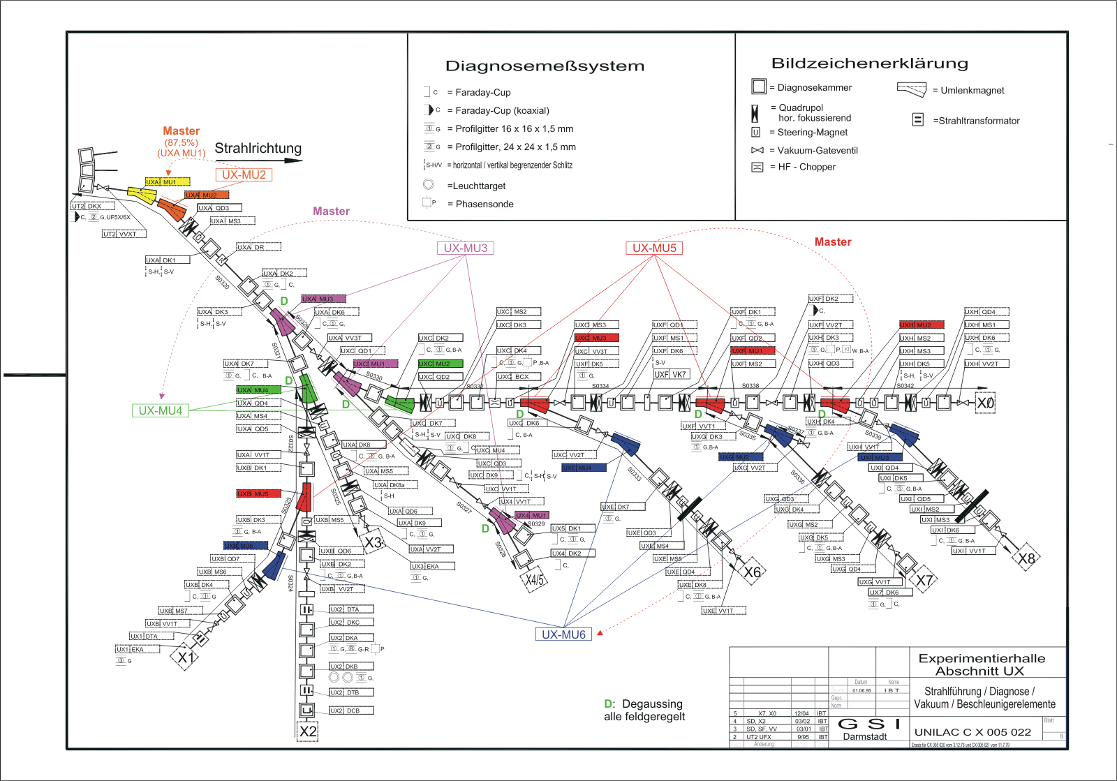
Timing Groups: EH dipole (and quads)
Single power supply serves magnets in different timing groups

