Slide 1
UNILAC Timing Overview
BSS GUI App:
UNILAC timing values -> to BSS
Scheduling App:
initial values, ... -> chain
?
?
FPGA:
UNILAC timing values
SIS18 pattern(groups)
-> UNILAC schedule
MakeRule:
chain -> chain timing graph(s)
???:
chain timing graph(s)
UNILAC schedule
-> timing graph
MASP:
Interlocks
Execution states (PG-Schutz, dry exec)
-> to BSS, to Data Master?
?
UNILAC Pulszentrale
from: R. Mueller et al., WEPV047, ICALEPCS2021

Slide 2
Timing groups
46 particle transfers (+4 pLinac)
~15+2 timing groups necessary/reasonable
7 existing timing sections

Slide 3
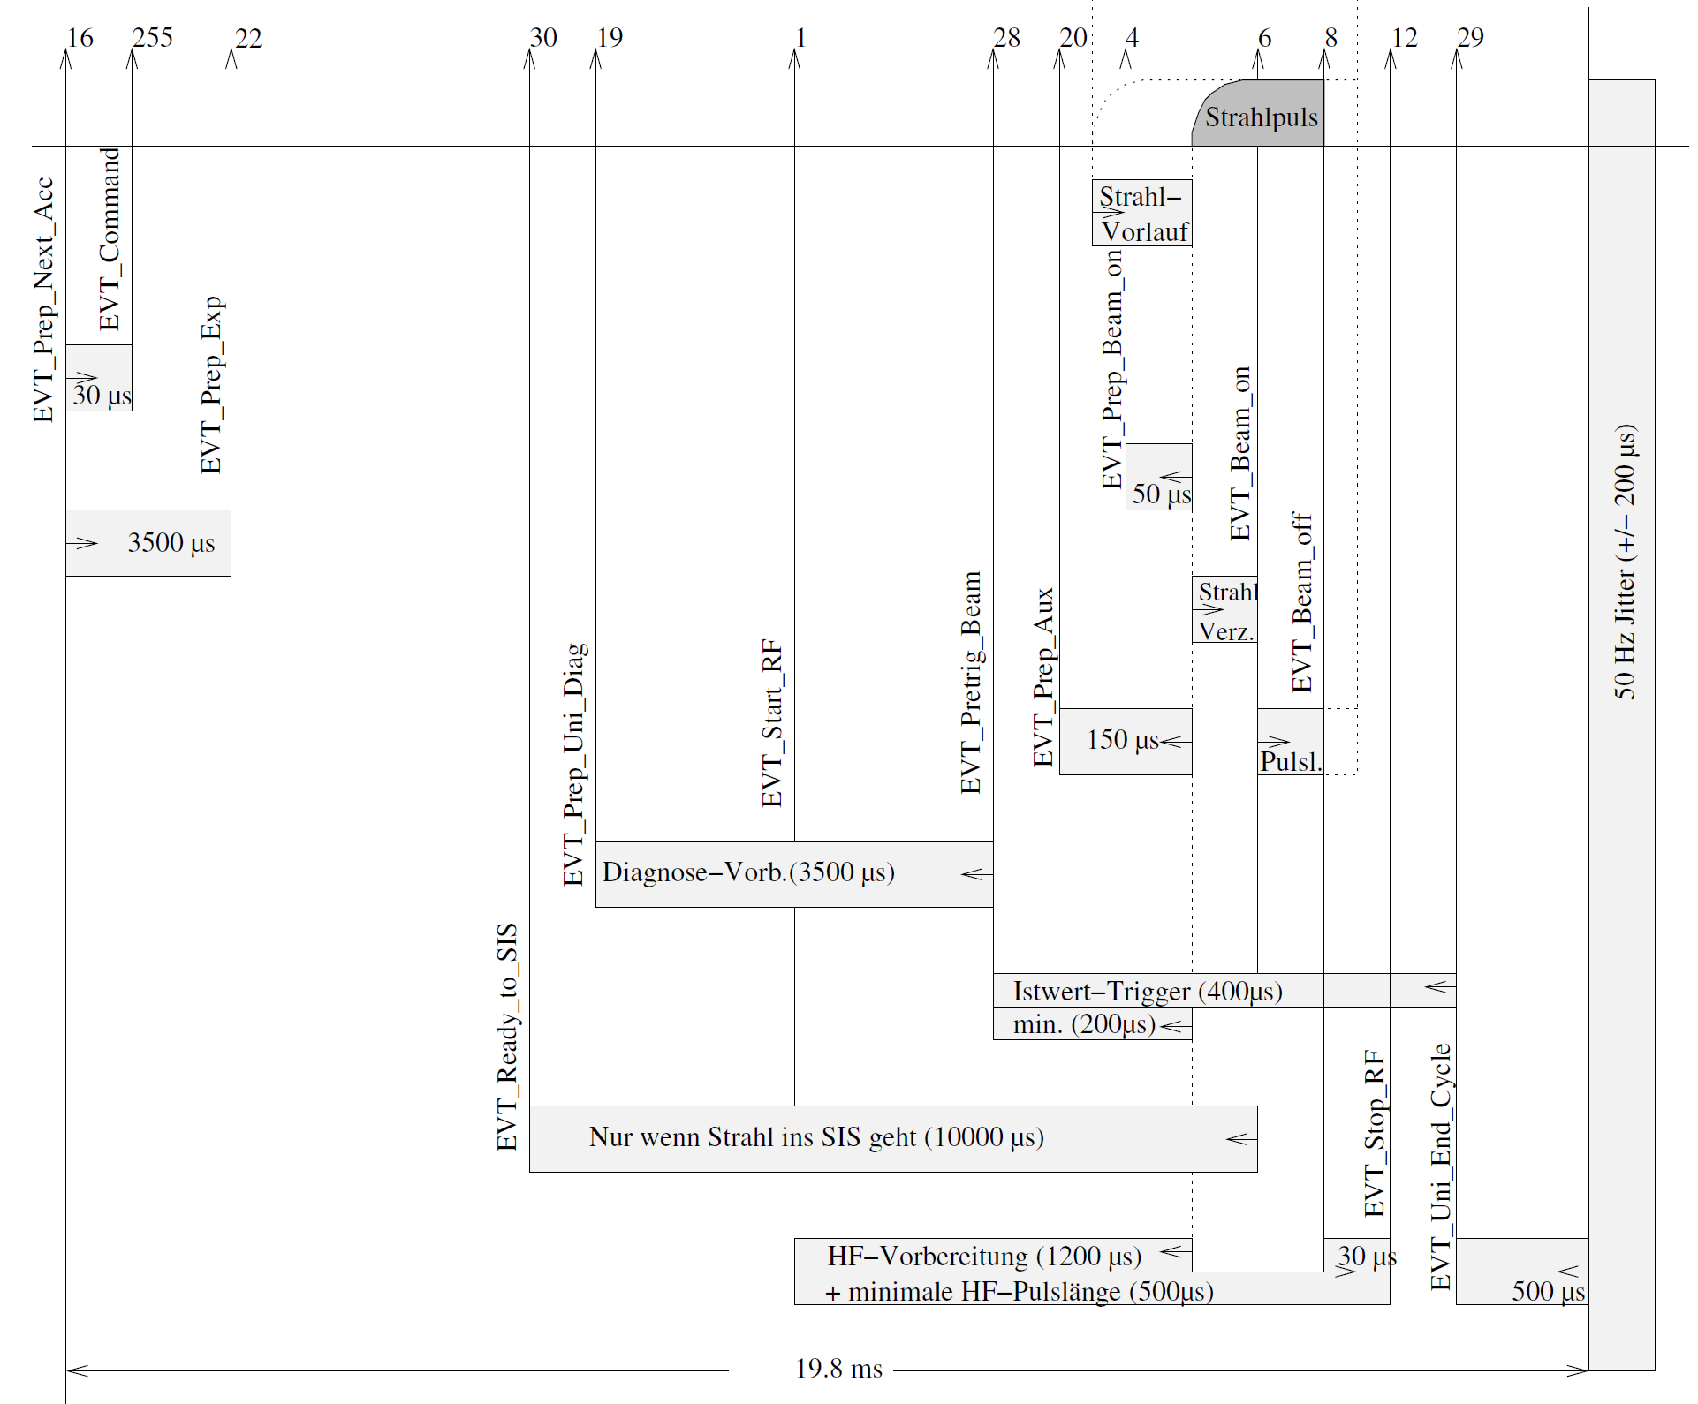
UNILAC timing parameters for chains & sources
Chains (accelerators):
beam pulse length (Pulslänge)
(good) beam delay (Strahlverzögerung)
prepulse / lead beam(Strahlvorlauf)
Sources:
source pulse length (Quellenpulslänge)
source lead (Vorlauf?)
Comments:
timing of chain and source are interrelated
timing parameters are independent of other settings and schedule (and vice versa)

Slide 4
Generation of UNILAC chain timing graph
Scheduling App: Initiate generation of chain (source), assign default values for timing parameters
  Beam production chains need source
LSA: MakeRule generates chain (source) timing graphs based on parameters and event dependencies
  with beam (source)
  without beam
  with short beam pulse (PG-Schutz)
  or all in one graph with conditional branching
Accordingly for sources and beam out-processes
  RF stabilization and conditioning
  TK preparation

Slide 5
Timing operation 1
Chain(s) introduced to BSS, timing graphs sent to BSS
Change of parameters (pulse length) via Paramodi -> LSA trim -> new graph -> ...

Slide 6
Generation of UNILAC schedule & timing graph
App/GUI?: Set schedule parameters
  Select defined chains to be executed
  Provide parameter values for execution:
    Repetition count (could be defined by other quantity)
    optional: special flags (w/o beam, strictly periodic, ...)
  Initiate schedule generation
    manually
    on demand (change of SIS pattern(groups))
FPGA:
  takes UNILAC execution parameters and injections from SIS pattern(groups)
  mimics Pulszentrale to produce a periodic schedule
Combine Schedule from FPGA and chain timing graphs into comprehensive timing graph?

Slide 7
Chain and source timing
Sources
Accelerator

