Slide 1
Concept for WR-based linac timing system
Present situation
  UNILAC multiplex operation, Pulszentrale in a nutshell
  Altering operational circumstances
  Timing constraints
Going for FAIR
  From Pulszentrale to Datamaster
  Deriving UNILAC & pLinac schedules for FAIR
  Schedule translation: Existing & FAIR control system
  Implement schedule for datamaster: Event sequence, supercycle
  Specialities
  Schedule creation and datamaster operation: System view
Missing & drawbacks
Timing Groups

Slide 2
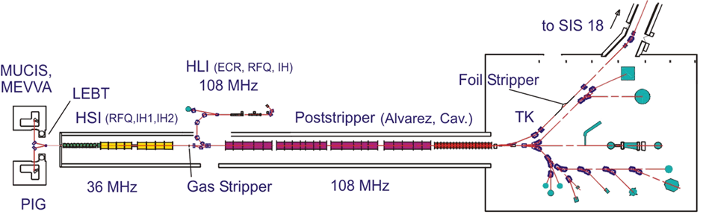
UNILAC multiplex operation
Parallel setup, time multiplex
Parallel operation per pulse / cycle, space multiplex

Slide 3
UNILAC Pulszentrale (UPZ) in a nutshell
Operating scenario
  One main user gets up to 50 Hz
  Secondary users get up to 5 Hz
  SIS18 handled upon request, merely “perturbation” of UNILAC operation
  Prerequisite of uninterrupted operation for stability reasons, e.g. beams with interlock continue to operate w/o beam
Based on repetition rates & requests
  Operation defined by nominal repetition rates for sources and beams
  Complemented by beams upon request
  No way foreseen to maintain strict rates, order or periodicity of beams
Source driven
  Repetition rates for sources are applied strictly*
  Whenever a source is ready, UPZ looks for consumer
Priority driven
  Simple, but highly efficient concept, based on counters
  Infrequent beams are privileged, frequent beams lose pulses; nominal repetition rates are rarely matched
  Unused cycles used for secondary tasks individually per timing section
  Some exceptions handled, e.g. SIS18 requests, increasing complexity
Real time system
  UPZ takes decisions for next cycle, no further knowledge by concept
  Devices have to follow within 15 ms
  Taking slow or limited devices into account is cumbersome
  Requests handled ad hoc, requestor has to wait for next available source pulse
  Specialities (profile grid guard) handled on best effort basis
*: alternatively operation upon request only is possible

Slide 4
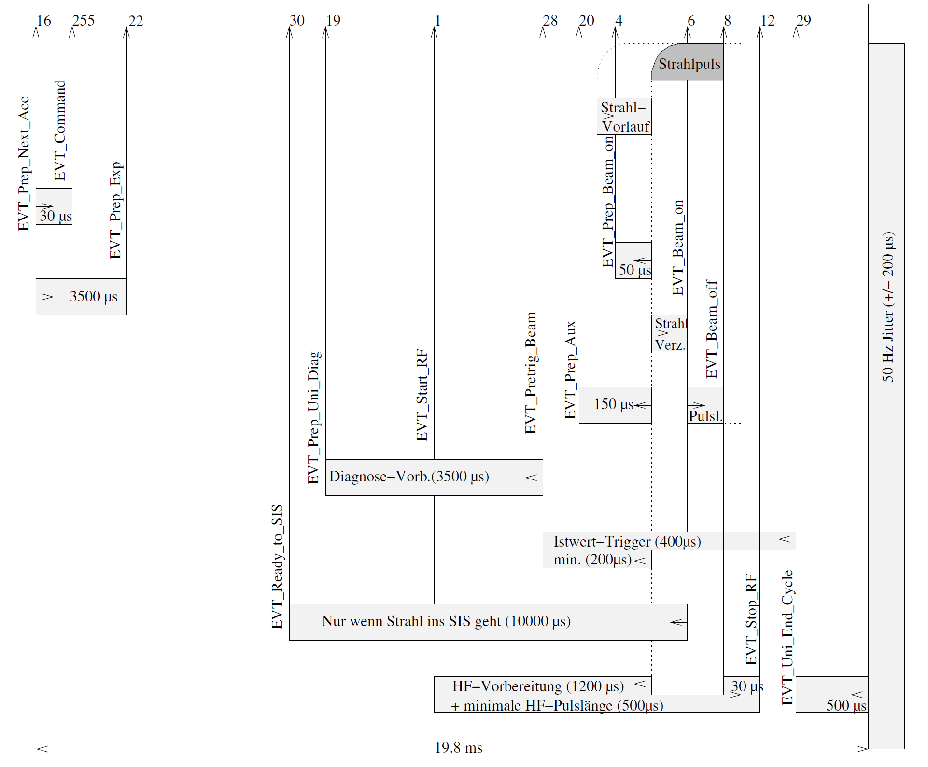
UNILAC event sequence: Fix – except pulse lengths
Operating parameters (pulse lengths)
Connection source-accelerator timing
(ion beam pulse start & stop at source)
Cycle length (20 ms)
Connection to absolute time
Sources
Accelerator

Slide 5
Altering operational circumstances
UNILAC becomes FAIR injector
  Timely beam delivery to SIS18 gets highest priority to support FAIR performance
  UNILAC users become second priority
  Handling SIS18 requests becomes more frequent, demanding
Facility increase
  Additional sources and linacs: pLinac, 3rd source terminal at HSI, 2nd source terminal at HLI, CW linac?
Tightening boundary conditions from UNILAC devices:
  Sources: Booster mode vs. service life
  Alvarez 4: Operation in narrow repetition rate window
  HSI: High-Bρ-limit, so far only considered in “planning”
  Magnet cycling restrictions increase in numbers (TK, HSI, QQ, Alvarez DT quads)
  TK: Long preparation time (already incorporated)
  Some UNILAC users longing for strictly periodic provisioning
  More stringent observation of PG guard needed due to higher beam intensities
⇒ More sophisticated planning and control of scheduling needed

Slide 6
Timing constraints (examples)
UNILAC has to be operated at 50 pulses/s without any interruptions
Sources:
  have to be pulsed most regularly (stability)
  may be used for fast booster cycles
  may not be used frequently for long (overheating)
  may not be used too infrequently (reliablity)
  should be used as few as possible (service life)
Alvarez 4:
  has to be used with 5-10 Hz (!), i.e. pulsed every 100-200 ms (every 5th - 10th cycle)
TK:
  needs to be prepared 200 ms before beam pulse when changing beam
  can be used faster for repetitions of same beam
HSI-RF:
  rigid beams at maximum 5 Hz, only limited observance implemented in Pulszentrale
Profile grid guard:
  limit beam pulses on grids to 2,5 Hz in total, only limited observance implemented in Pulszentrale

Slide 7
Concept for WR-based linac timing system
Present situation
  UNILAC multiplex operation, Pulszentrale in a nutshell
  Altering operational circumstances
  Timing constraints
Going for FAIR
  From Pulszentrale to Datamaster
  Deriving UNILAC & pLinac schedules for FAIR
  Schedule translation: Existing & FAIR control system; excursion: Terms
  Implement schedule for datamaster: Event sequence, supercycle
  Specialities
  Schedule creation and datamaster operation: System view
Missing & drawbacks
Timing Groups

Slide 8
From Pulszentrale to Datamaster
UNILAC Pulszentrale
Datamaster
integrated real time scheduling
  “simple” priority system
  very efficient, uses every pulse
  allows for on-demand requested pulses
  hard to implement more sophistication or to plan in advance
  no strict control of operation (≠ sources)
  relies on fast, flexible devices (unlimited resources)
  becomes tricky with slow, restricted devices
ensures uninterrupted operation
prompt beam delivery for SIS18 actually can not be ensured
pre-planned periodic/looped schedule
  sophisticated planning tool could be realized in software
  pre-planned schedule can not be changed in real time
  drop concept of requested beams
  enables optimal use of limited resources by arbitration
  enables prompt delivery to SIS18, maximize FAIR efficiency; contingency for setup
has to ensure uninterrupted operation
limited real time reactions needed for UNILAC (PG guard)

Slide 9
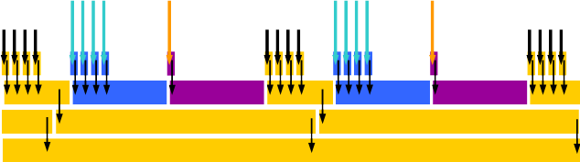
Deriving UNILAC & pLinac schedules part 1: Infer FAIR requests
Available / defined
linac beams
UNILAC
pLinac
SIS18
SIS100
CR
HESR
SIS18 defines beams from UNILAC & pLinac
LSA Basics for Developers, J. Fitzek
Patterns / BPCs … to SIS18
from UNILAC
from pLinac

Slide 10
Deriving UNILAC & pLinac schedules part 2: Add local linac beams
Available / defined
linac beams
FAIR global periodicity
UNILAC
pLinac
SIS18
SIS100
CR
HESR
SIS18 defines beams from UNILAC & pLinac
LSA Basics for Developers, J. Fitzek
Starting point:
Upgrade
stepwise
as needed
Patterns / BPCs … to SIS18
local
Periodic pattern,
predetermined, fixed
from UNILAC
from pLinac
(modular local patterns)
…
Monolithic schedule:
inflexible, memory consuming, static,
easy to plan and implement
Modular schedule:
flexible, memory conserving, adaptable to schedule changes at FAIR, complex to plan and implement

Slide 11
Deriving UNILAC & pLinac schedules part 3: Building the schedule
FAIR global periodicity
1) FAIR requests:
beam pulses & timing
…
time
2) Extract UNILAC & pLinac
BPCs and timing,
allocate timing groups,
add resources
pLinac
QL
QR
HSI
…
…
…
ALV
3) Add UNILAC and pLinac
local BPCs, stabilizers, conditioners, …
keep concept of repetition rates
TK
A4
4) Optimize …

Slide 12
Schedule translation: Existing control system
Virtual accelerators
VirtAcc | Timing sections
 | HSI | HLI | ALV | EH | TK
01 | 01 | - | 01 | - | 01
02 | - | 02 | 02 | 02 | -
03 | - | 03 | - | - | -
04 | 04 | - | - | - | -
05 | - | - | - | - | 05
15 | 15-HSI | 15-HLI | 15-ALV | - | 15-TK
VirtAcc 15: Stabilizer, individual settings for every timing section
Superzyklus
Pulse | VirtAcc | HSI | HLI | ALV | EH | TK | SIS18
1 | 1+3 | 01 | 03 | 01 | - | 01 | SIS_A
2 | 2+5 | - | 02 | 02 | 02 | 05
3 | 2 | - | 02 | 02 | 02 | -
4 | 2+4+5 | 04 | 02 | 02 | 02 | 05
5 | 2 | - | 02 | 02 | 02 | -
6 | 1+3 | 01 | 03 | 01 | - | 01 | SIS_B
… | … | … | … | … | … | …

Slide 13
Example schedule: Translation to FAIR control system
Existing control system
FAIR control system
Virtual accelerators
Beam processes, beam production chains, sequences
VirtAcc | Timing sections
 | HSI | HLI | ALV | EH | TK
01 | 01 | - | 01 | - | 01
02 | - | 02 | 02 | 02 | -
03 | - | 03 | - | - | -
04 | 04 | - | - | - | -
05 | - | - | - | - | 05
15 | 15-HSI | 15-HLI | 15-ALV | - | 15-TK
BPC / Sequence | Particle Transfer / Timing Group
 | HSI | HLI | ALV | EH | TK
01 | HSI01 | - | ALV01 | - | TK01
02 | - | HLI02 | ALV02 | EH02 | -
03 | - | HLI03 | - | - | -
04 | HSI04 | - | - | - | -
05 | - | - | - | - | TK05
15 | HSI15 | HLI15 | ALV15 | - | TK15
VirtAcc 15: Stabilizer, individual settings for every timing section
Sequence = VirtAcc
Superzyklus
Pattern
Pattern
 | BPC
Pulse | Sequence | HSI | HLI | ALV | EH | TK | SIS18
1 | 1A+3 | HSI01 | HLI03 | ALV01 | - | TK01 | SIS_BPC_A
2 | 2+5 | - | HLI02 | ALV02 | EH02 | TK05
3 | 2 | - | HLI02 | ALV02 | EH02 | -
4 | 2+4+5 | HSI04 | HLI02 | ALV02 | EH02 | TK05
5 | 2 | - | HLI02 | ALV02 | EH02 | -
6 | 1B+3 | HSI01 | HLI03 | ALV01 | - | TK01 | SIS_BPC_B
… | … | … | … | … | … | …
Pulse | VirtAcc | HSI | HLI | ALV | EH | TK | SIS18
1 | 1+3 | 01 | 03 | 01 | - | 01 | SIS_A
2 | 2+5 | - | 02 | 02 | 02 | 05
3 | 2 | - | 02 | 02 | 02 | -
4 | 2+4+5 | 04 | 02 | 02 | 02 | 05
5 | 2 | - | 02 | 02 | 02 | -
6 | 1+3 | 01 | 03 | 01 | - | 01 | SIS_B
… | … | … | … | … | … | …

Slide 14
Implementation: UNILAC beam process
Sources
Accelerator
Beam process (= event sequence)
Beam process (= event sequence)
associated to timing group

Slide 15
Implementation: Linac supercycle
Supercycle (pattern, schedule) as loop / periodic graph
  Nodes contain beam processes
Required procedures:
  Supercycle exchange
  Beam process exchange (all BP of one BPC atomic)
  SC / BP exchange independent, without interruption
  Additionally real time, “instantaneous” adaptations of beam processes, e.g. PG guard
Graphs may get large (50 nodes/s, >100s)
  Nodes contain redundant information
  Change of one beam process applies to many copies
  Change of large pattern graph expensive, unnecessary
⇒ Separate beam processes (=event message data) from graph

Slide 16
Separating supercycle and beam processes
Event message data (beam processes) stored separately
  One node per beam process per timing group
Graph contains beam process indices only
  Beam processes called from supercycle, need pointers
  Event messages generated
  Callback to supercycle (not shown)
  Reduced memory usage
Exchange of beam process
  Generate nodes with new version of all beam processes belonging to one BPC
  Change all pointers from supercycle to nodes
  Atomic operation!
⇒ Reduce number of pointers to be changed
⇒ Merge beam process nodes to chain nodes

Slide 17
Merge beam processes, insert abstraction layer
Merge beam process nodes to one BPC node
  Contains all timing messages, hence all information for one beam production chain
Hide BPC nodes by static wrappers
  Contain only pointer to BPC node
  Many pointers in supercycle direct to static wrapper
  ⇒ pointers and supercycle not affected by BPC exchange
Supercycle and wrappers contain only BPC index
Exchange of beam process
  Generate one new node with new version of BPC timing messages
  Change one pointer from wrapper to this node

Slide 18
Supercycle execution
Single supercycle
Multithreaded, one worker thread per BPC
  Branch to BPC node if index in cycle
  Generate timing messages for BPC
  Callback
  Go to next supercycle node
Synchronization mechanism available
Arbitration mechanism available
  thread with nearest event gets executed next

Slide 19
Standard operation features
Changing beam pulse length
  Aim: Change length of source or beam pulse, source advance, …
  Occurrence: Frequently, should be quick
    Can be done without interference of pattern or other beam processes
    Generate new version of corresponding node
    Load new version into datamaster
    Change pointer to new version
    Delete old versions (optional)
Changing supercycle
  Aim: Introduce new beam, change execution rate of beam or source, …
  Occurrence: Seldom, may take some time, may not interrupt operation, has side effects on accelerator (magnet hysteresis, rf)
    Generate new supercycle
    Load new supercycle into datamaster
    At exit point of old supercycle, switch to corresponding entry point in new
    Delete old supercycle (optional)

Slide 20
Real time reaction: PG guard
Profile grid guard needs two adaptations
  Reduction of pulse length
    = adaptation of beam process
    Variant 1: Always generate second version of beam process with reduced pulse length, switch pointer; needs second wrapper
    Variant 2: Include alternative, conditional timing messages for both, switch by tag
  Reduction of beam pulses
    Execution of pulses without beam by tagging of normal beam process
Corresponding action (w/o pulse or reduced length) has to be predefined in supercycle coherently per pulse for all BPCs
Real time reactions:
  Determine all beam production chains affected by PG guard setting (outside datamaster?)
  Signal to datamaster BPCs affected
  Switch pointers and / or tag BPCs

Slide 21
Periodic TK on demand
Simple approach:
Create supercycles w/o and with periodic TK execution
On request switch between supercycles
Requires base supercycle + one per BPC to be switched
Flexible approach:
Reserve cycles [TK] in supercycle for periodic execution of any appropriate BPC in TK
Attach reserved cycles [TK] to VOID
On request, attach [TK] to requested BPC
Problems:
Gets tricky when several BPCs (from >1 sources) are involved
Reserve all resources possibly needed (sources!) for all [TK] cycles
Leave enough cycles between [TK] and all other involved BPCs
May have large impact on beam delivery performance
Difficult to use reserved cycles when no periodic execution is requested

Slide 22
Shorten BPC (Zwischenziel)
Approach:
Create alternative set of BPs for BPC, incorporate only BPs for TGs of shorter beam path
Switch to alternative set
Optional: Add rf stabilisation for then unused TGs, but in Pause!
Comment:
Dirty: Mechanism does not care where the beam is dumped!!!
If pulse length is changed, all BP-sets have to be changed always

Slide 23
UNILAC schedule creation
IPD > ???
PZU > ???
UPZ > LSA
Def. UNILAC-SIS18 beams
ion, energy; -> BPC, BPs, settings
Define ion sources
ion (element, isotope, charge state)
Def. UNILAC-local user beams
ion, energy; -> BPC, BPs, settings
Define ion source pulses
timing by repetition rate range
Supercycle
SIS18 beams
ion, energy, …
Merge source & UNILAC-SIS18
+ add residual source pulses
UNILAC-local users beam pulses
timing by repetition rates as today
+ features (strict rate, order, bursts, …)
FAIR pattern
…
Add UNILAC-local users
Add auxiliaries
UNILAC auxiliaries
stabilisation, conditioning
UNILAC-SIS18 beam pulses
derive timing from FAIR pattern
on time, fixed, contingency
Optimisation & Check
level rates, order, remove source pulses …
check compliance with rules and limits
statistics
finalize pattern
Display & approve
set optimisation targets
manual intervention
?
Pulse length
Event messages
per BP(C); template
Send to datamaster
Event / timing message sequence

Slide 24
UNILAC datamaster operation
Real time on demand switching
PG guard: switch affected BPC to BPC’
Shorten BPC: switch from BPC to BPC’
Periodic TK: switch to alternate supercycle
Supercycle generation
Create / purge BPC
Include / exclude BP(C)
BPs 1n
Datamaster
BPs 1n’
UNILAC
Ion source rate
Beam rep. rate
Stabilization …
Enable periodic
BPs 1
Supercycle A
BPs 1’
Event / timing message sequence
BPs 2
BPs 2’
Pulse length
BPs n
BPs 3
Supercycle B
BPs 3’
SIS18
energy, cooling, extraction …
⁞
⁞
⁞
FAIR pattern

Slide 25
Missing & drawbacks
Missing
  generating exit & entry points for supercycles; poor man’s solution: start / end of periodicity
  integrity checks
  rarely executed FAIR BPCs (storage rings with long cycle times)
  …
Long FAIR periodicity:
  Large pre-calculated patterns need lots of memory in datamaster
  Resort: Use several small periodic patterns in hierarchical pattern structure, branch as needed
  Complex to build, care for transitions
UNILAC pattern / supercycles would have to be adapted to any change in SIS18 …
  … pattern
    Modularize UNILAC pattern similar to SIS18 pattern (see above)
    Enable single execution of extra patterns
    Challenges mentioned above
  … cycle time
    Introduce buffer times to allow (small) changes in SIS18 cycle time during setup
    Eliminate buffer times on stable SIS18 operation
    Needs UNILAC-SIS18 sync as now, SIS18 waiting for UNILAC
  Non-periodic beam requests could be handled in the same way

Slide 26
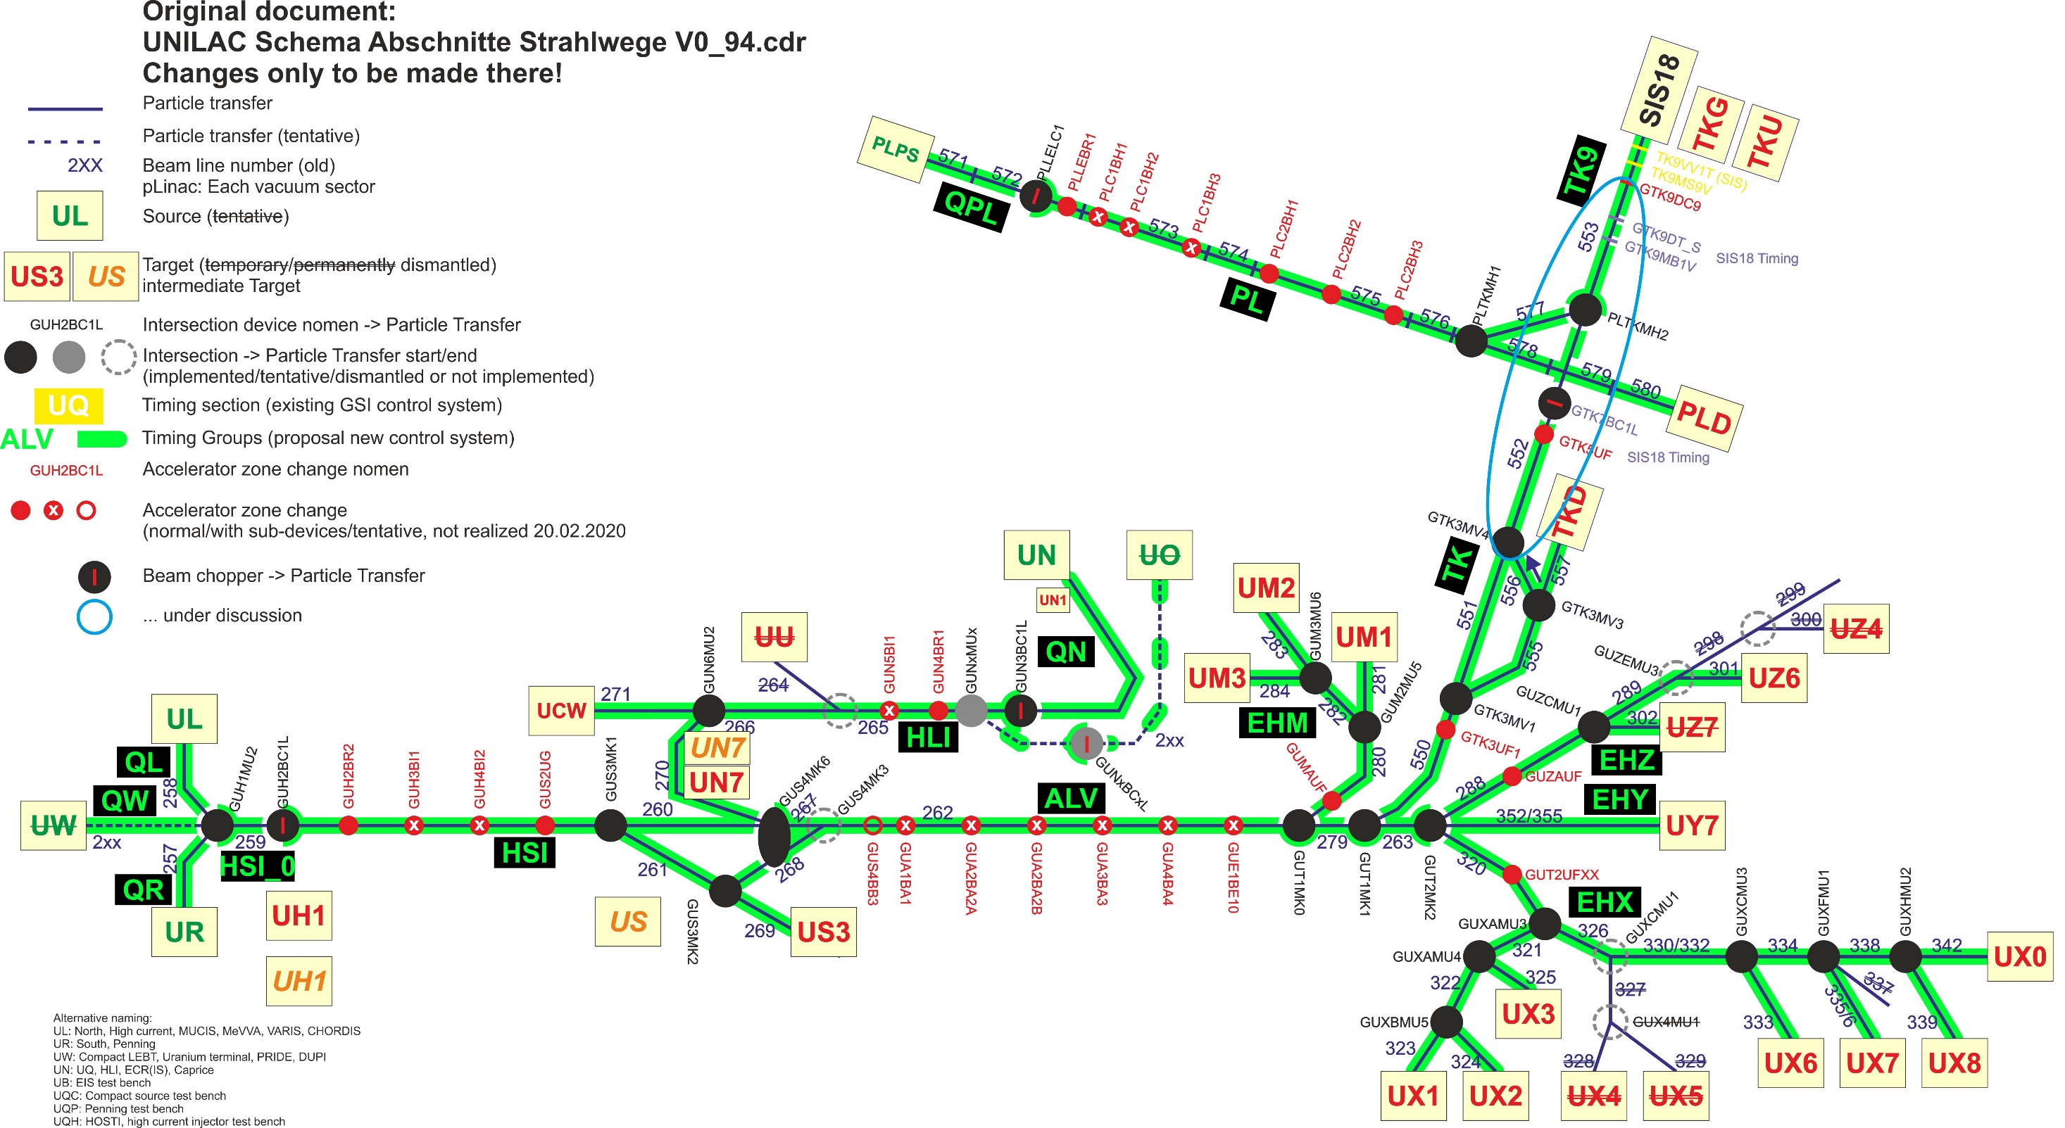

Slide 27
Timing Groups
Fragen zu (Super-)Timing Groups:
  Dipole in der EH kompatibel mit FAIR-TG-Konzept?
  Super-Timing Groups durch Ausmaskieren der Event-ID?
  GUN6MU2_TO_UCW eigenes Timing oder HLI-Timing?
  2. Quelle HLI?
Intern zu klären:
  STG Poststripper inkl. UT1MK0, UT1MK1 bis inkl. UT2MK2? Oder eigene TG UT1MK1_TO_UT2MK2 notwendig?
  Wie wird eigentlich zur Zeit das Timing in UH1 gemacht? An sich UH-Timing, aber Pulslänge=Quellenpulslänge(UR,UL)?

Slide 28
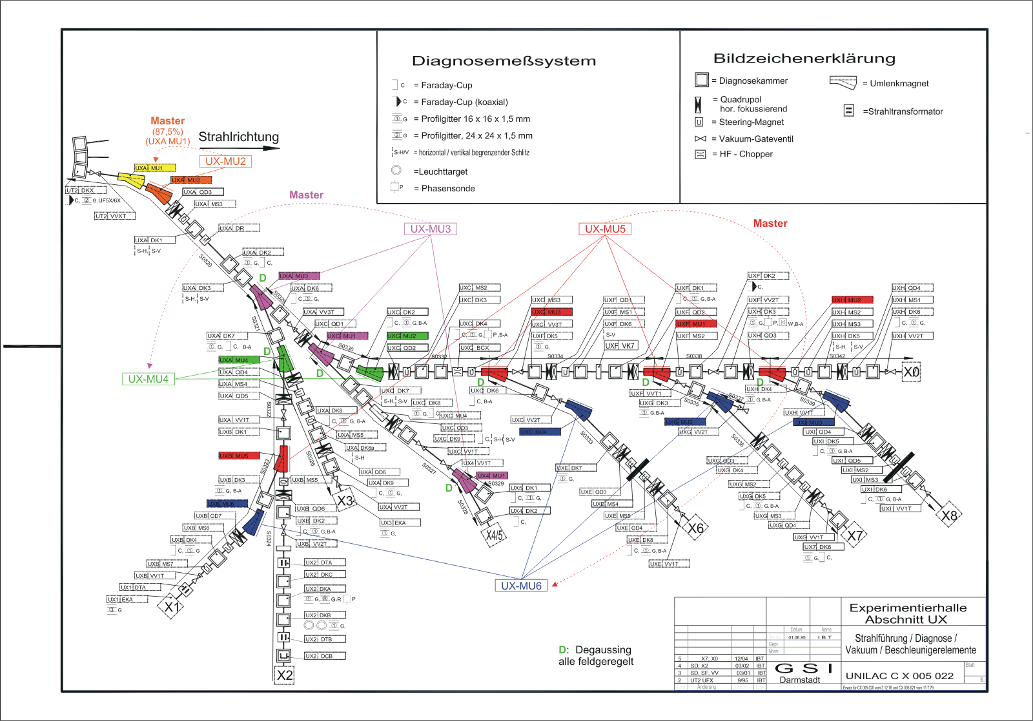
Timing Groups: EH dipole

Slide 29
Backup

Slide 30
Excursion: Terms
Beam processes, beam production chains, sequences
field = beam process
row = beam production chain (same colour)
row = sequence (=virtacc?)
BPC / Sequence | Particle Transfer / Timing Group
 | HSI | HLI | ALV | EH | TK
01 | HSI01 | - | ALV01 | - | TK01
02 | - | HLI02 | ALV02 | EH02 | -
03 | - | HLI03 | - | - | -
04 | HSI04 | - | - | - | -
05 | - | - | - | - | TK05
15 | HSI15 | HLI15 | ALV15 | - | TK15
02 | - | HLI02 | ALV07 | EH06 | -
Sequence = VirtAcc
Sequence 02: “not necessarily the same Sequence index between
particle transfers”
field = beam process
row = pulse / UNILAC cycle (50 Hz)
row = several beam production chains (same colour) simultaneously
row = several sequences simultaneously
(but in variable combinations)
= pattern
The same UNILAC-BPC may serve several SIS18-BPCs (01>A, 01>B)
-> different sequences / BPCs?
-> DeviceAccess!
Pattern
Pattern
 | BPC
Pulse | Sequence | HSI | HLI | ALV | EH | TK | SIS18
1 | 1A+3 | HSI01 | HLI03 | ALV01 | - | TK01 | SIS_BPC_A
2 | 2+5 | - | HLI02 | ALV02 | EH02 | TK05
3 | 2 | - | HLI02 | ALV02 | EH02 | -
4 | 2+4+5 | HSI04 | HLI02 | ALV02 | EH02 | TK05
5 | 2 | - | HLI02 | ALV02 | EH02 | -
6 | 1B+3 | HSI01 | HLI03 | ALV01 | - | TK01 | SIS_BPC_B
… | … | … | … | … | … | …

Slide 31
Implementation: Linac supercycle
Supercycle (pattern, schedule) as loop / periodic graph
  Nodes contain beam processes
  Two approaches
    Monolithic: Whole schedule in one loop, all beam processes for cycle in one node
    One loop per timing group: More flexible, needs synchronization
Required procedures:
  Supercycle exchange
  Beam process exchange (all BP of one BPC atomic)
  SC / BP exchange independent, without interruption
  Additionally real time, “instantaneous” adaptations of beam processes, e.g. PG guard
Graphs may get large (50 nodes/s, >100s)
  Nodes contain redundant information
  Change of one beam process applies to many copies
  Change of large pattern graph expensive, unnecessary
⇒ Separate beam processes (=event message data) from graph

Slide 32
Change beam process 1
1) New beam process provided
2) Switching all pointers: Has to be done atomic, simultaneously for all (up to ~40) timing groups
Timing
group
QL
Timing
group
HSI
Timing
group
ALV
Timing
group
TK

Slide 33
Change beam process 2
Structure:
Only one supercycle
One static first layer wrapper per BPC / sequence
One second layer wrapper per BPC / sequence
One set of beam processes per BPC / sequence, one BP per timing group
All beam processes of one set called from second order wrapper
Change beam process:
Provide new set of beam processes incl. new second layer wrapper, w/o connection to first layer
Switch pointer from first to second layer wrapper
Question: Callback necessary at all?

Slide 34
Change beam process 3
Structure:
Only one supercycle, nodes contain indices of BPCs / sequences to be executed
One static wrapper per BPC / sequence
One set of beam processes per BPC / sequence, one BP per timing group
Several wrappers may be called from one supercycle node simultaneously
Set of BPs (=BPC) called by one pointer via one wrapper
Change beam process:
Provide new set of beam processes
Switch one pointer from wrapper to new set
PG guard, switch one BPC / sequence to “No Beam” or “No Execution”
Provide alternative set of beam processes
Switch one pointer from wrapper to alternative set on demand
… or use tagging when possible
Question: Callback necessary at all?

