Slide 1
Injector Controls Upgrade Project
BEAM TIME RETREAT 2023
BEAM TME RETREAT 2023
Modernisation of Control System for injector chain (ion sources, UNILAC, TK)
Complete modernisation → beyond scope of this presentation
Main objectives: Fit for FAIR (e.g. booster mode) and keep the system operable
Replacement of UNILAC controls is a complex endeavor
Lessons learned from replacement of SIS18/ESR controls
Careful planning & communication is the key for success
Project plan revised in 05/2023
Commissioning 2025 aligned with strategic operation schedule
Detailed planning to be further refined in 11/2025 (BEA/OPE/…)

Slide 2
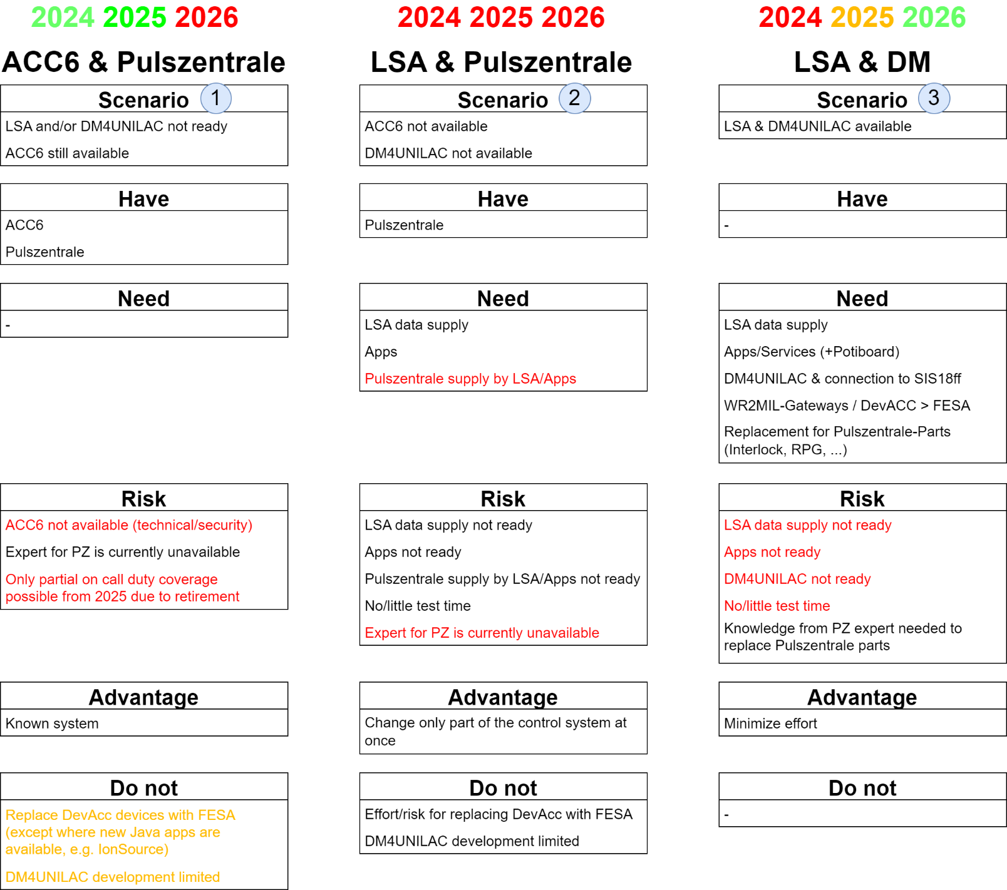
UNILAC Controls Transition Decision on Strategy for 2024-26
BEAM TIME RETREAT 2023
BEAM TME RETREAT 2023
Main considerations
Support beamtimes 2024 and 2025
Extend operation of legacy control system ACC6 & Pulszentrale
Assure readiness of new control system LSA & DM for beamtimes 2025 and 2026
Minimize risk and effort
Risk Mitigation
"Emergency System" for BT 2025
Intermediate development step

Slide 3
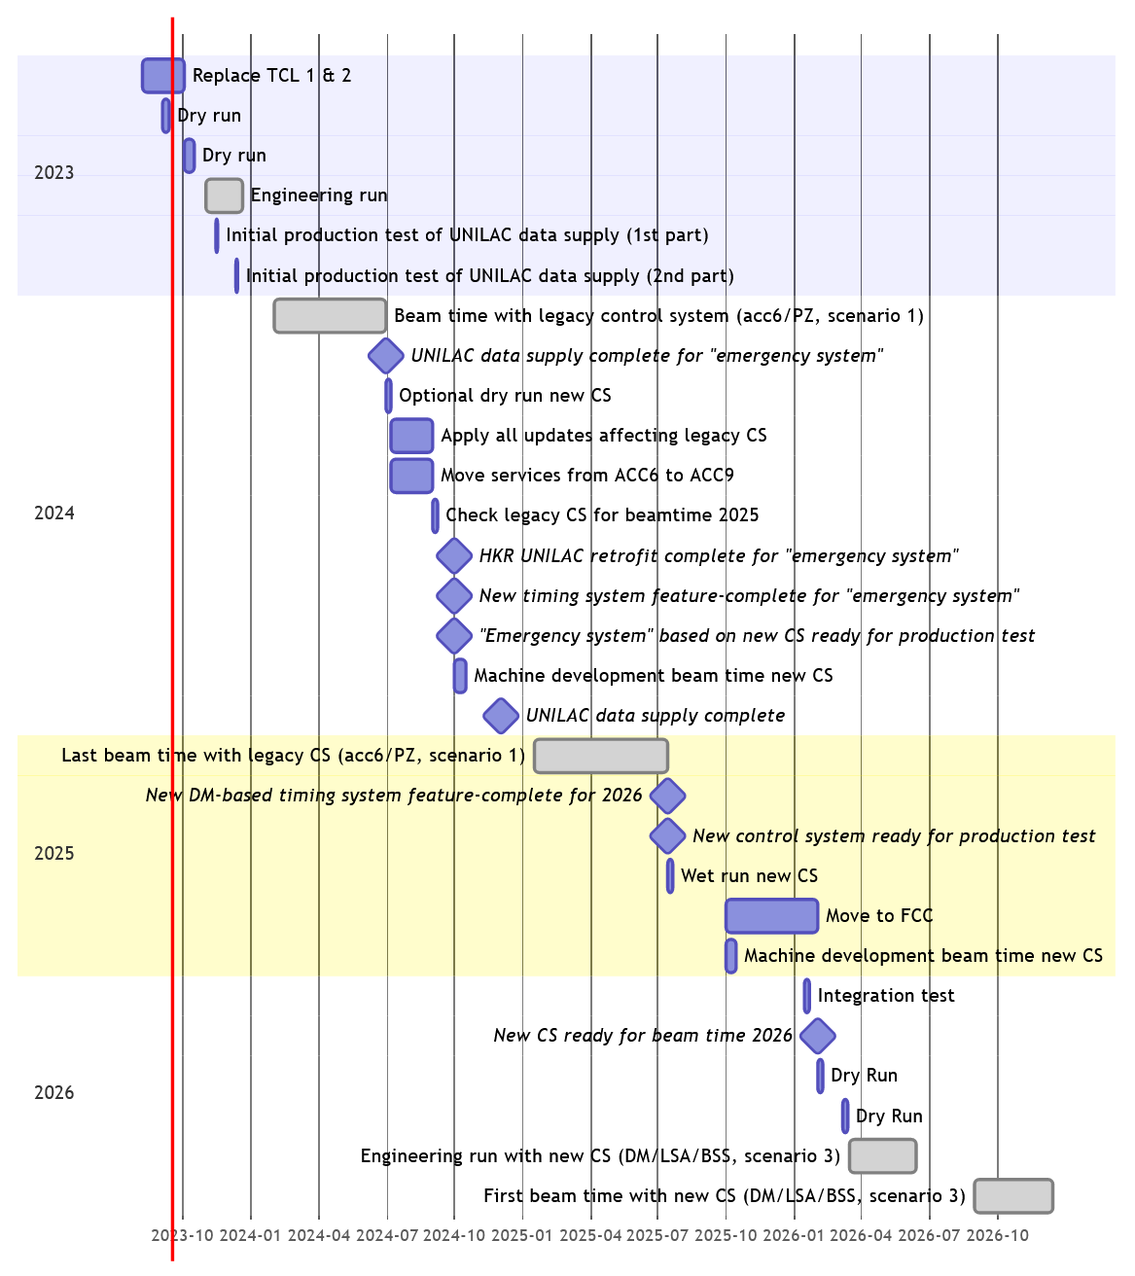
UNILAC Controls Transition Timeline until 2026
BEAM TIME RETREAT 2023
BEAM TME RETREAT 2023
Obligations

Slide 4
UNILAC Controls Transition Timeline until 2026
BEAM TIME RETREAT 2023
BEAM TME RETREAT 2023
Top level
milestones

Slide 5
UNILAC Controls Transition Timeline until 2026
BEAM TIME RETREAT 2023
BEAM TME RETREAT 2023
Testing
periods

Slide 6
UNILAC Controls Transition Timeline until 2026
BEAM TIME RETREAT 2023
BEAM TME RETREAT 2023
Legacy
system
maintenance

Slide 7
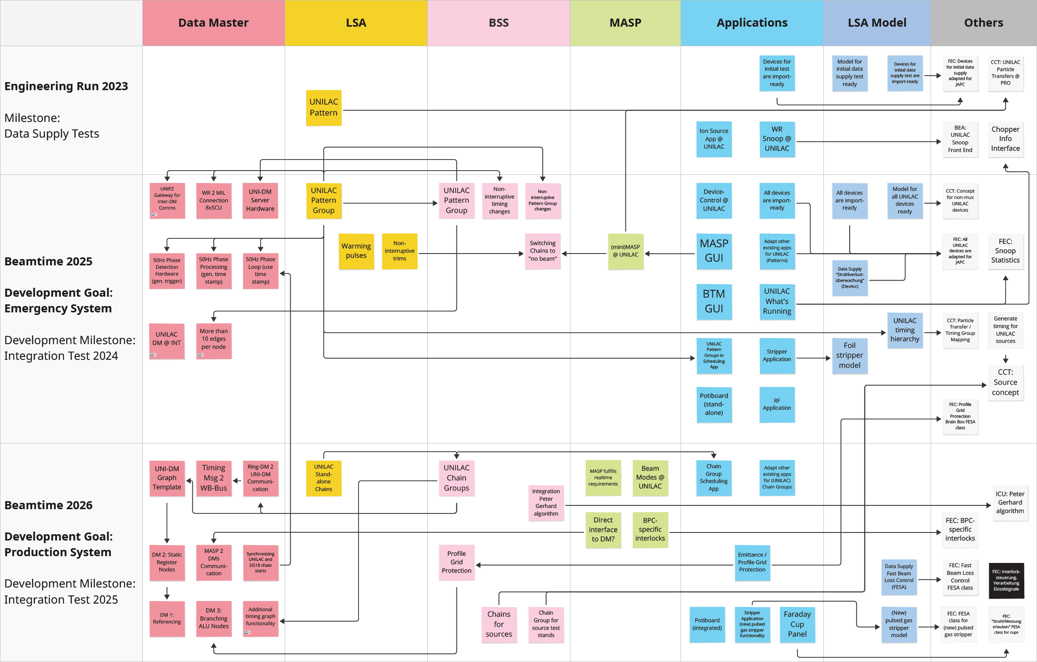
UNILAC Controls Transition Milestone Overview until 2026
BEAM TIME RETREAT 2023
BEAM TME RETREAT 2023
Stepwise adaptation, extension and development of existing control system
Support of other departments essential (BEA, SYS, OPE)
APP development effort exceeds capacity

Slide 8
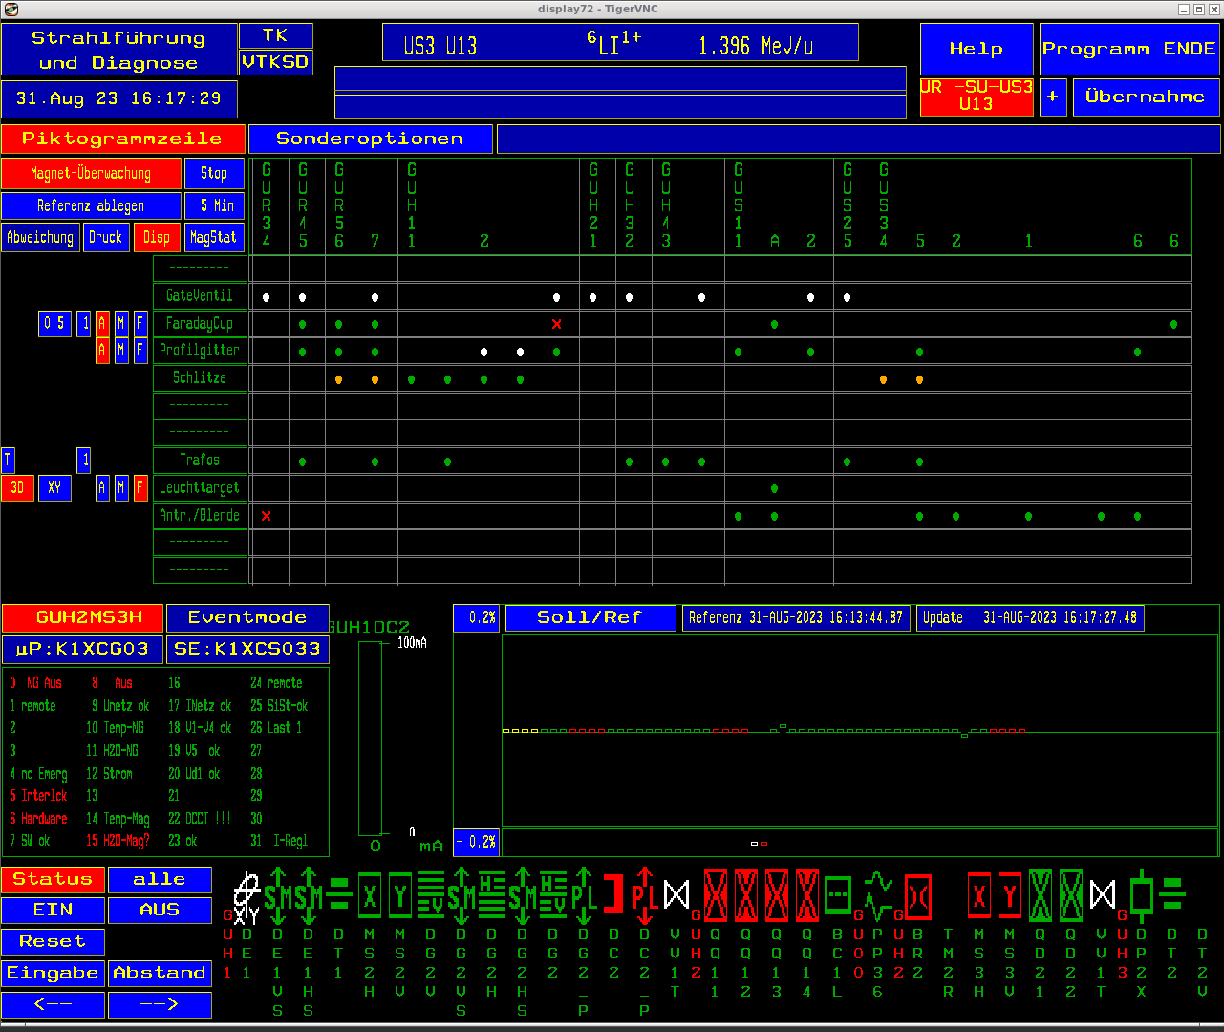
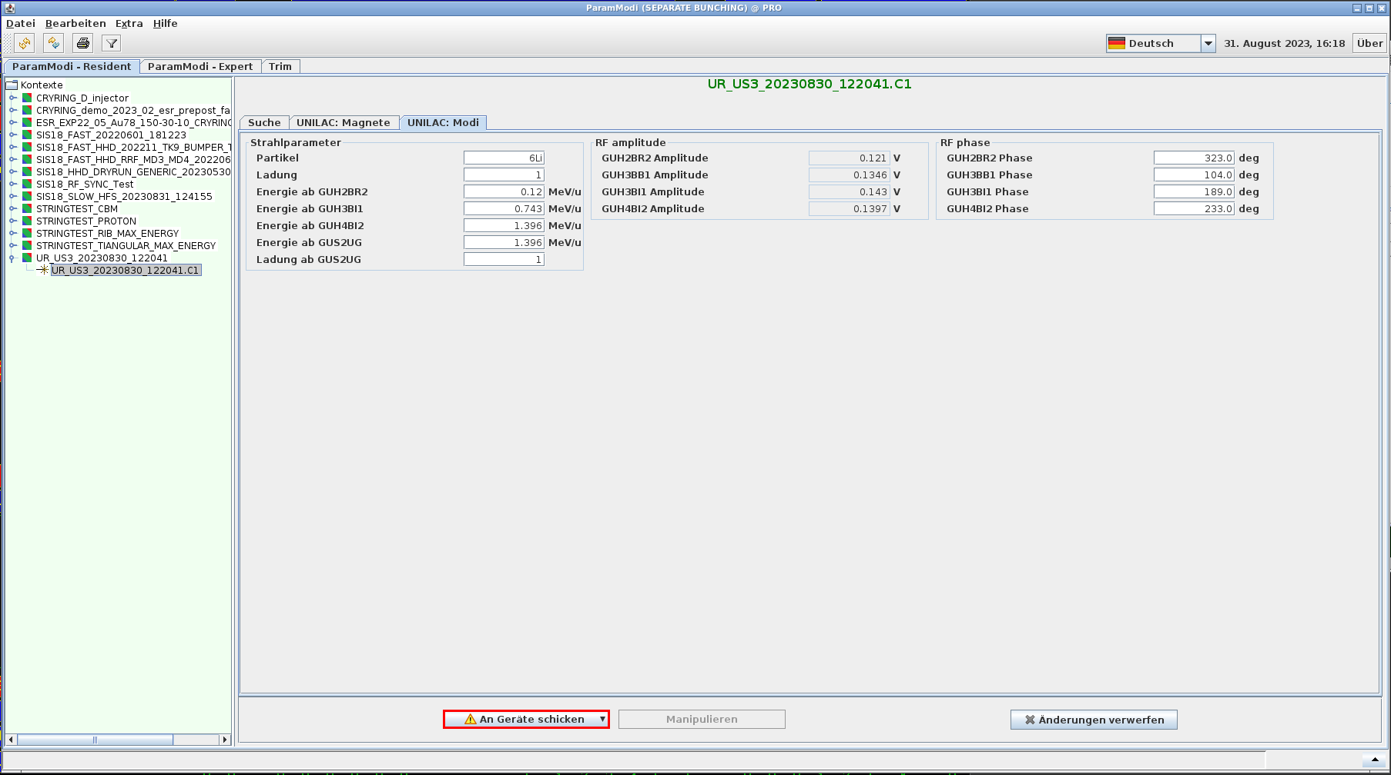
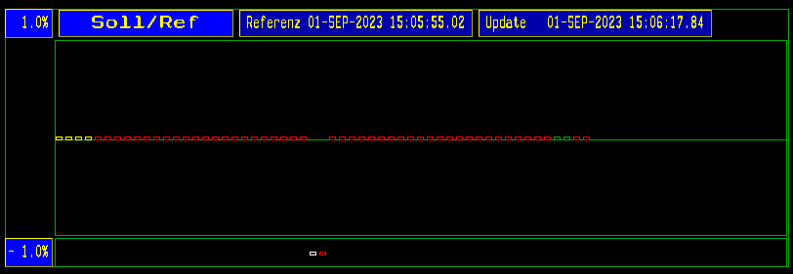
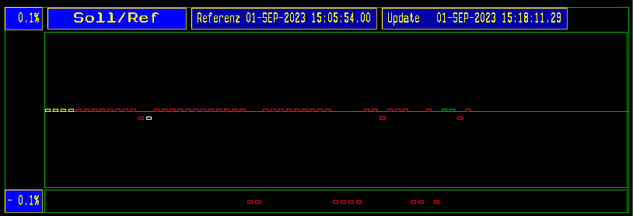
UNILAC Controls Transition Highlight: First LSA@UNILAC Test in Dry-run 08/2023
BEAM TIME RETREAT 2023
BEAM TME RETREAT 2023
LSA setting supply of 47 magnets of 3 device types @HSI
Supply settings for identical beams from both old and new control system
Also tested for different beams from new control system (not shown)
Old
New
Should be identical!
small deviations ⇒ check
large deviations ⇒ error found

Slide 9
UNILAC Controls Transition Strategy and Challenges
BEAM TIME RETREAT 2023
BEAM TME RETREAT 2023
Extend operation of legacy control system
Software: end of life ⇒ use extended support, check availability after patching
Hardware: obsolete
short-term: maintain or exchange where necessary
long-term: upgrade path to new technologies, go as soon as possible
Maintenance: loss of experts
Migration, development of new control system
Short time, few development cycles → request additional testing possibilities, concentrate on basic operability, new features later
Loss of experts and expertise of the legacy system
Commissioning of new control system for beamtime 2026
Learn and benefit from commissioning experience at SIS18 and ESR
Close coordination with OPE and users in preparation of the beamtime 2026

Slide 10
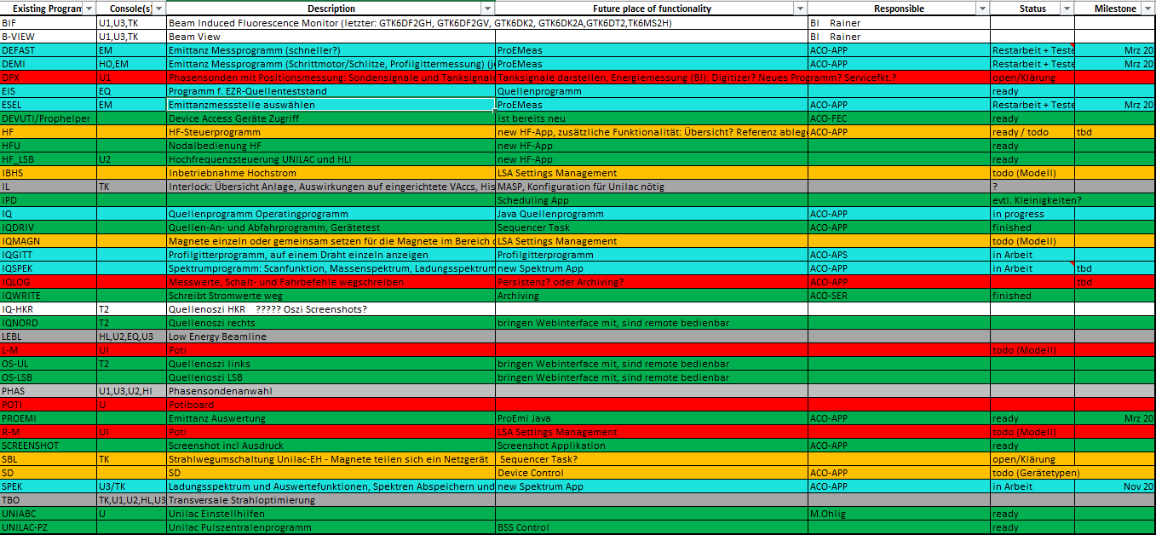
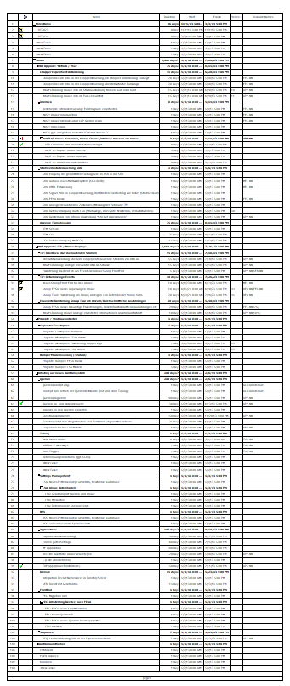
Controls Upgrade for UNILAC Control Room Applications (1)
BEAM TIME RETREAT 2023
BEAM TME RETREAT 2023
List of Applications / Mapping of Functionality exists
First rough planning done
Detailed planning in work
New Applications
IonSource → in work
Spectrum → started
UNILAC What’s Running → 2025 (first mock-ups started)
Profile Grid Protection App → 2025
BTM GUI (2 step approach) → 2025
HF App → 2024/25
Faraday-Cup-Panel App → 2024/25
Adaptation of existing new Apps
MASP GUI for UNILAC → 2024
Snoop GUI for UNILAC → 2024
LSA Data Supply
UNILAC Machine Model → Peter Gerhard, S. Jülicher (in work)
SVÜ (Fast beam loss control) Data Supply → 2025

Slide 11
Controls Upgrade for UNILAC Control Room Applications (2)
BEAM TIME RETREAT 2023
BEAM TME RETREAT 2023
Work started
Test use of first applications targeting the Ion Sources already in the Engineering Run:
IonSource Application for HLI, Profile Grid Application, IonSource sequences, Emittance App
Lots of upgrade tasks, new applications as well as adaptations of existing applications
Tight resource constraints
Estimates exceed capacity of the team
Mitigations
FAIR "urgent items support contract" (Cosylab), work started
Labour leasing (Arbeitnehmerüberlassung/Ferchau) → no candidate yet
Early re-staffing of open position for the early retirement → urgently needed, blocked

