Slide 1
CMW-Admin
Joel Lauener BE-CO-IN

Slide 2
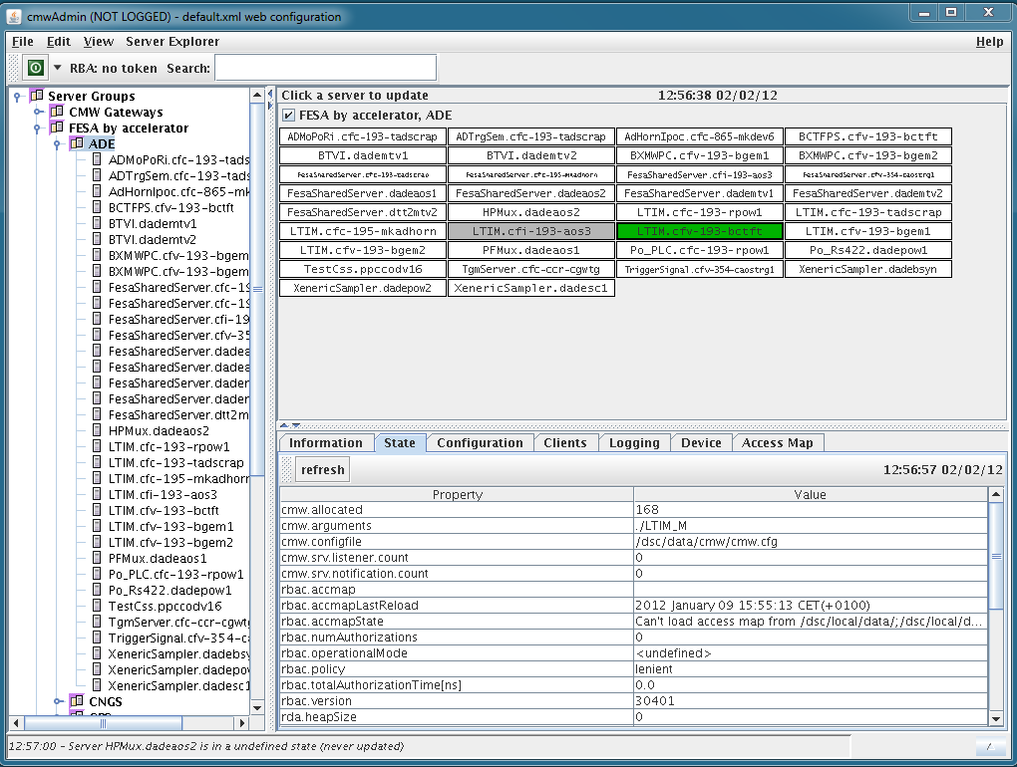
CMW-Admin
Administration GUI for CMW device servers (FESA, FGC, GM, PROXY, PVSS)
Major changes under the hood
New log viewer
New device explorer
Proxy functionalities
Server search

Slide 3
CMW-Admin

Slide 4
CMW-Logging
Common logging system for all CMW servers.
New server logging infrastructure
Client libraries (Java/C++/C)
Infrastructure (JMS server, converters, DB)
Graphical User interface
Database Web interface for history
Not limited to the CMW domain (Timing, Drivers)
http://wikis/display/MW/Log+and+Tracing

Slide 5
CMW-Admin Hand’s on
How to start CMW-Admin
From our Wiki: http://wikis/display/MW
From a Linux terminal by typing ‘cmwadmin’
Video 1: Finding a server in CMW-Admin
Video 2: Looking inside a server
Video 3: Analyzing server logs

Slide 6
Questions
Need help? cmw-support@cern.ch

