Slide 1


Controls Configuration Service
Overview
GSI
29.11.2012
Antonio
on behalf of the Controls Configuration team
Beams Department
Controls Group
Data & Applications Section

Slide 2

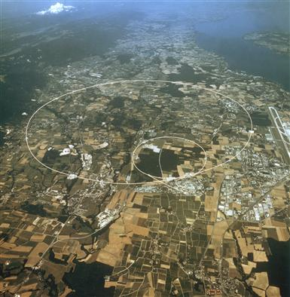
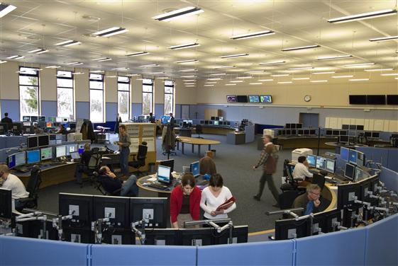

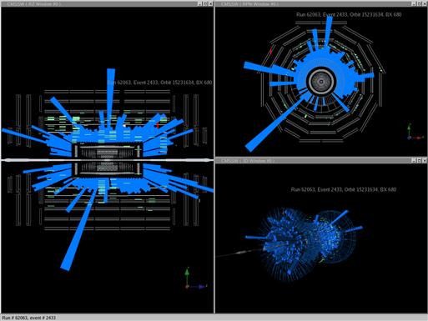
Outline
Configuration Management
Controls Configuration Team
Scope & Main Configuration Functionalities Overview
Controls Configuration Service Overview

Slide 3
Configuration Management
Established as part of Systems Engineering
  during the 1950s - hardware configuration management
  as of 1980s includes software configuration management as well
Configuration Management comprises of the processes of:
  Identifying and defining the items in a system
  Controlling the change of these items throughout their lifecycle
  Recording and reporting the status of items and change requests
  Audit configuration items to verify conformance to specifications
Part of best practices and standards
  part of ISO 9000, formalized by Information Technologies Infrastructure Library (ITIL), Control Objectives for IT (COBIT), IEEE standards, etc.

Slide 4
Configuration Management
The Accelerators Controls System – a complex systems with a lot of components
  Large amount of technical data required for the Control of the accelerators
Main advantage of the Configuration Management
  A common description, in a centralized storage, of all objects needed for the Controls of the accelerators
    Essential prerequisite for the correct and coherent functioning of the accelerators
Notes:
provide the on-line data for the configuration items and their relationships

Slide 5
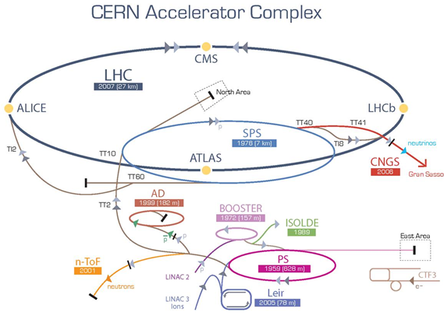
Controls Configuration Management History
1980 - idea to use a central data storage to describe the components of the Controls System for the Proton Sychrotron (PS) complex
Service with >30 years of history – supporting the requirements of the PS, SPS and LHC complexes nowadays
  It implements the configuration processes necessary for the different systems and comprises of a database, various applications to interact with the data, APIs and scripts
  Constantly evolving, growing in
  size and in provided functionality
  Achievement:
  Data-driven Controls system
Notes:
in order to cover the increasing complexity of the
accelerators Controls System at CERN

Slide 6

Outline
Configuration Management
Controls Configuration Team
Scope & Main Configuration Functionalities
Controls Configuration Service Overview

Slide 7




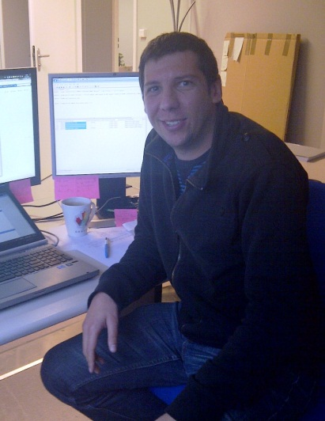
Controls Configuration Team
Zornitsa Zaharieva – Project leader and service responsible; system architect; QA
Zereyakob Makonnen – Link person to the Diamon team; responsible for Beam Interlocks &
Safe Machine Parameters Configs
Antonio Romero Marin – Link person to the FESA team; Timing Configuration responsible
Jose Rolland Lopez de Coca – Reporting solutions; responsible Config Feedback, Oasis
Aurelien Fernandez – Link person to the FESA team; responsible for Postmortem
Controls Configuration Support: Controls-Configuration.Support@cern.ch
Notes:
Some of the major responsibilities are given on this slide

Slide 8

Outline
Configuration Management
Controls Configuration Team
Scope & Main Configuration Functionalities
Controls Configuration Service Overview

Slide 9
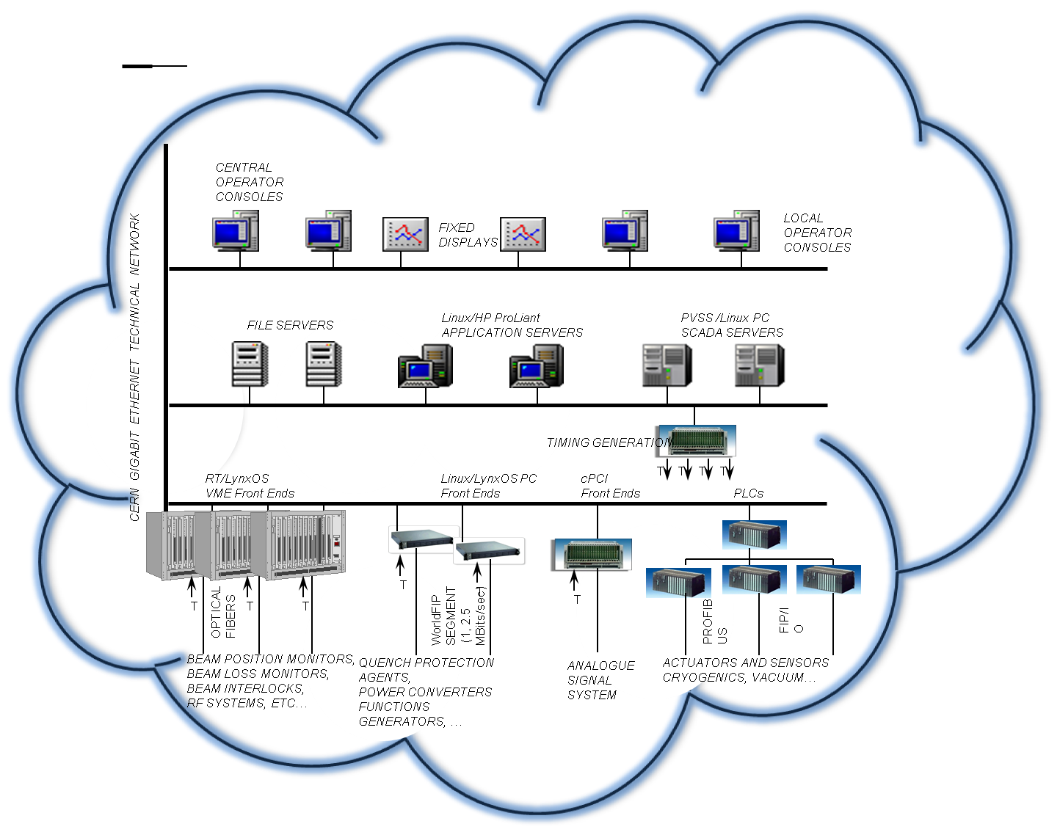
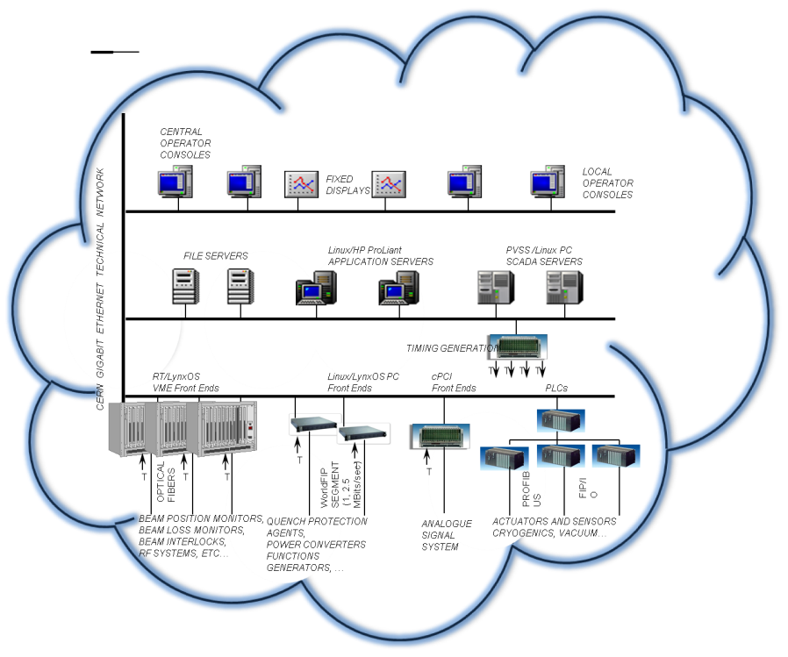

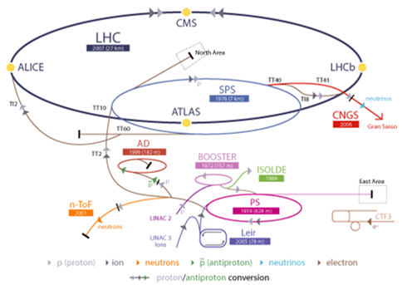


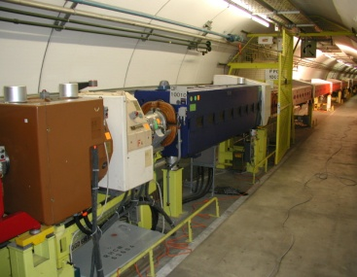
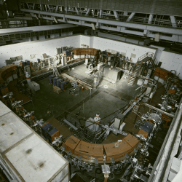
Controls Configuration Scope
Controls Systems Infrastructure
The heart of the CERN Accelerators Controls System - mission critical service
Configuration of components of the Controls System itself, e.g. Front-End computers, Accelerators Timing, CMW, Operators Consoles, etc.
Configuration of accelerator components for all accelerators, as seen by the Controls System, e.g. Power converters, Collimators, RF cavities, etc. – controls devices & properties (FESA, Hardware, Virtual, GM, SL)
Accelerator Complex
Notes:
The Controls Configuration is the heart of the CERN Accelerators Controls System. Nowadays it covers the need for the configuration of components of the Controls System itself, e.g. the Controls Middleware (CMW), as well as accelerator components as seen by the Controls System, e.g. power converters, for all accelerators: the Large Hadron Collider (LHC), the Super Proton Synchrotron (SPS) Complex, the Proton Synchrotron (PS) Complex, and the CLIC Test Facility (CTF3). The configurations of some components used for the Control Systems for the Technical Infrastructure services at CERN are done in the CCDB too.

Slide 10


Main Configuration Functionalities
  Identification and configuration of components of the Controls System
    Serves as a repository for the data for configuration items and their relationships, required for the correct functioning of the Controls System
  Configuration change management
  Extraction of Configurations
    Data-driven Controls System
  On-line Feedback of
  deployed configurations
Controls Configuration DB
PL/SQL APIs
Drivers gen, FESA, etc
Pro*C scripts
FECs configs, GM, etc.
XML config
files,
Binaries, etc.
Notes:
Extraction of Configurations – Data-Driven Controls System
The CCDB is not merely a storage repository for the configuration of the different components, related to the Controls of the accelerator. The CCDB actively serves to provide real-time configuration data, which is extracted from the database whenever a component needs to be configured. In order to provide the on-line data for the configuration items and their relationships, there are a number of APIs and scripts which have been developed.
Configuration Change Management
For the data-driven Controls System the data in the CCDB describes the Controls components and their properties. Those components need to be upgraded regularly, e.g. Front-End Computers, Device Classes, etc, therefore there is a need for regular data modifications and maintenance in the CCDB.
Each configuration item in CCDB is uniquely identified, which allows the database to trace the history of all operations (data modifications) performed on that item. The users are provided with reports on the current configuration and its evolution over time.
A solution to review potential configuration changes and accept or reject them is under development. The change acceptance process is mainly guided by the status of a given component (operational or not) and whether a change is considered to be backward compatible [6].
On-line Feedback of Deployed Configurations
A recently implemented new feature of the Controls Configuration is the availability of status accounting of the different configuration items. The status data comes in the form of a feedback from the configured components identifying the currently loaded configuration.
The first configuration items to start sending feedback data are the drivers for the Front-End computer modules and some components from the CMW configurations. This feature of the Controls Configuration Management is extremely important as it solves the years-old problems of discrepancies between the loaded Front-End configurations and the current running configurations, resulting in an unexpected behaviour after a reboot.
It is previewed that this functionality will be extended to cover other areas of the Controls Configuration in the near future, e.g. the software devices configurations deployed on the Front-Ends, etc.

Slide 11

Outline
Configuration Management
Controls Configuration Team
Scope & Main Configuration Functionalities
Controls Configuration Service Overview

Slide 12


Controls Configuration Database
Database complexity
  Model the Controls System into a relational database, maintain data consistency while enforcing the business rules
Database high availability – 24/7/365
Database Statistics
Tables | 1,120
Constraints | 3,163
Lines PL/SQL code | 70,000
Volume | 105 GB
RAC Cluster
Notes:
Providing the configuration capabilities for such a diverse number of systems and components and representing them in a unified model is quite a challenge. Currently the relational database model of the CCDB comprises of 914 tables, storing over 10GB of current reference data and 50GB of historical versioned data.
The Controls Configuration services need to be continuously available 24 hours a day, 365 days a year to assure the ability to configure components at any moment in order to operate the various accelerators at CERN as well as to allow configuration changes to be introduced during scheduled accelerator “technical stops”. This has been achieved through the use of Oracle cluster technology (RAC) which guarantees not only the hardware but also database software redundancy. This solution ensures no down time even during routine software patching of the database.
RAC Cluster

Slide 13
Configuration Service Overview
  The database is the core of the Controls Configuration Service
  The data in the CCDB represents components and their properties as seen by the Controls System
Controls Configuration Database Areas
Role-Based
Access
Configuration
Computers
Configurations
hardware, drivers
software, cables
( FECs, PLCs,
PVSS servers, etc.)
Accelerators Timing System Configuration
Diagnostics &
Monitoring
Configuration
Alarms
Configuration
Controls Middleware
Video Observation
System
Configuration
Controls Devices & Property Model
(GM, Hardware, FESA, Virtual, SL frameworks)
Fixed Displays
Configuration
Beam Interlock
Systems
Configuration
Safe Machine Parameters
Configuration
Power
Converters
Configuration
Devices Working
Sets & Metaproperties
Configuration
Common Console
Manager
Configuration
OASIS
Config
Notes:
Providing the configuration capabilities for such a diverse number of systems and components and representing them in a unified model is quite a challenge. Currently the relational database model of the CCDB comprises of 914 tables, storing over 10GB of current reference data and 50GB of historical versioned data.

Slide 14
Configuration Service DB Areas
    5 device-property models: GM, SL, FESA, HARDWARE, VIRTUAL
  All controls devices (~80,000) and parameters (~ 2,000,000)
  Role-Based Access to devices and their properties
  Hardware and software configuration of Computers (~3 000), Drivers generation, etc
  The Accelerators Timing System
  Controls Middleware – proxies – computers resolution, devices servers directory
  Diagnostics and Monitoring System configuration – agents configuration for monitoring the complete controls computers infrastructure, configuration of the DIAMON consoles, etc.
Notes:
Providing the configuration capabilities for such a diverse number of systems and components and representing them in a unified model is quite a challenge. Currently the relational database model of the CCDB comprises of 914 tables, storing over 10GB of current reference data and 50GB of historical versioned data.

Slide 15

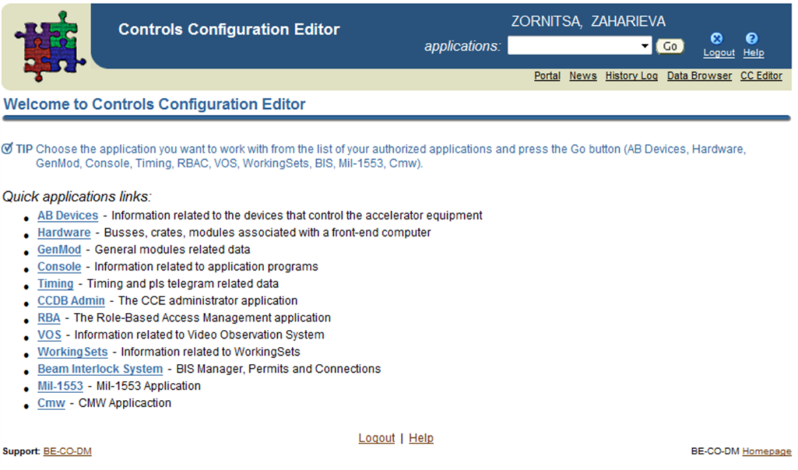

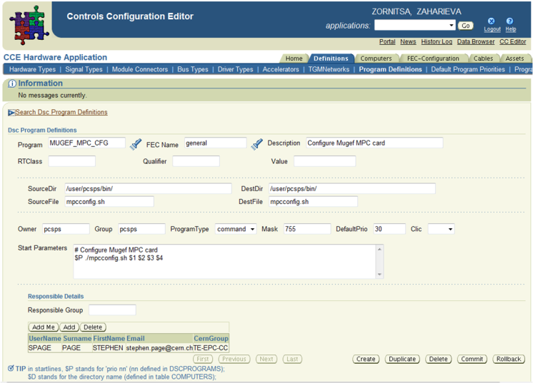
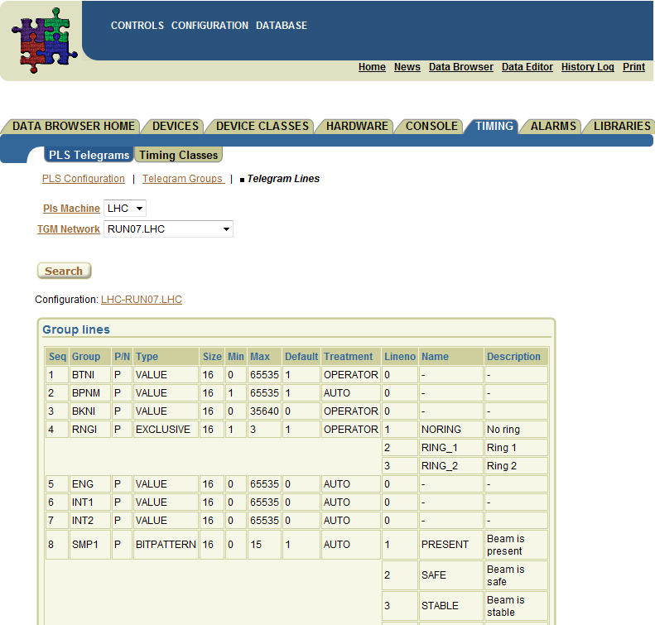
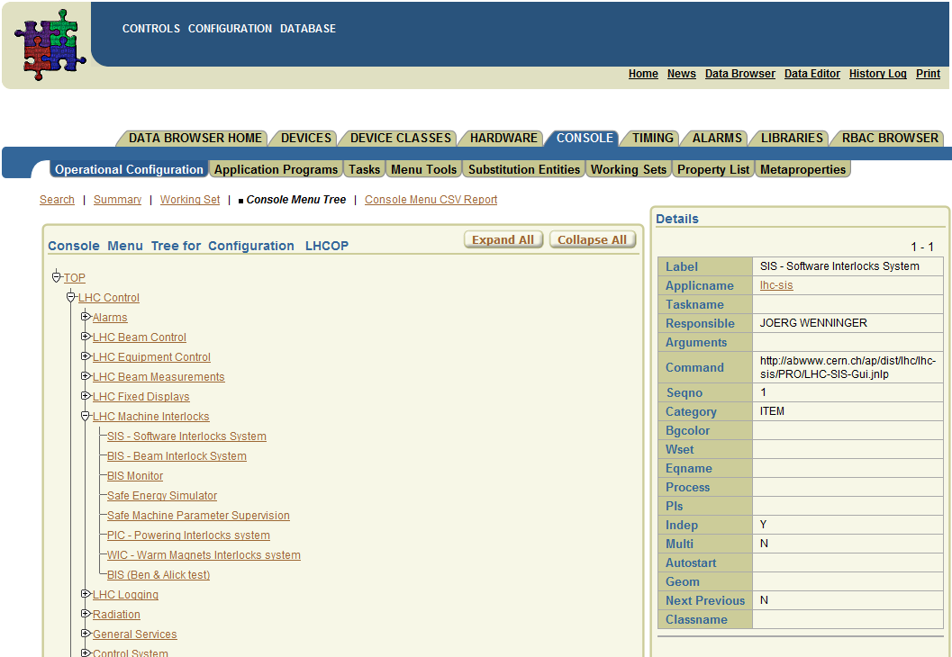
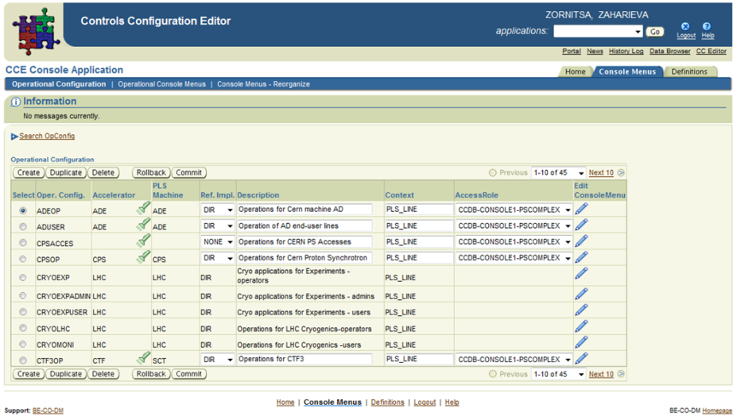


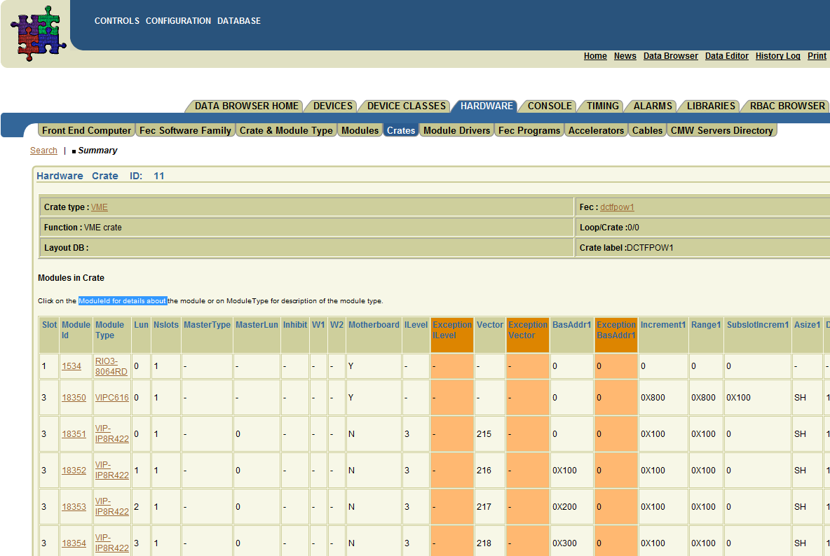
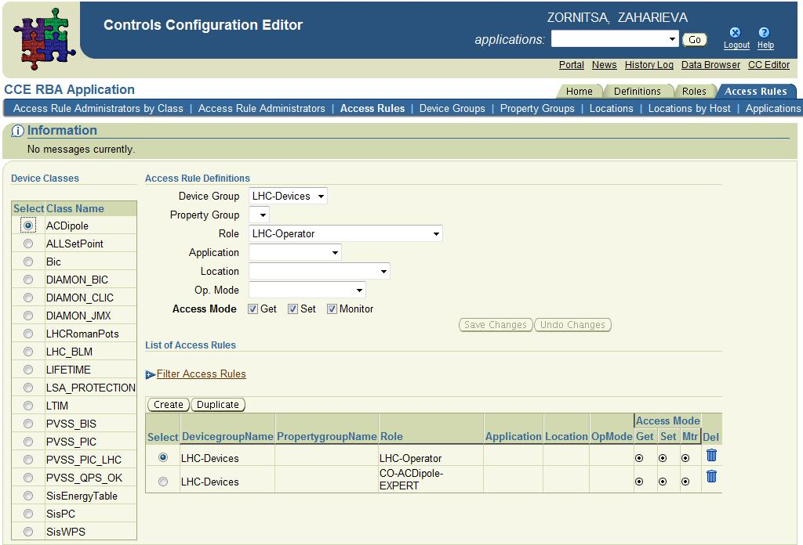
Configuration Data Responsibility
Diverse user community - challenging to provide user applications
  Equipment experts from BE, TE, EN departments
  Controls experts
  Operators
Maintaining the correctness of the data lies within the users
A set of data editing and browsing interfaces are provided
Controls Configuration DB
Equipment Experts
CO Experts
Operators
Controls Configuration Graphical User Interfaces
User Community
Operators
Controls Experts
Accelerators Equipment
Experts
Data Editing Interfaces
ð 12 Data Editors
ð Oracle J2EE ADF technology
ð 250 users
ð Strict authorization
ð Fine grain access control
Data Browsing Interfaces
  ð Window-on-data
  ð 160 reports
  ð Oracle APEX technology
  ð 300 users
Notes:
There is a diverse user community for the Controls Configuration services, which makes the job of providing tailored user applications challenging. The responsibility to maintain the correctness of the configuration data lies with the relevant equipment experts (BI, RF, etc.), as well as controls experts and accelerator operators

Slide 16
Web-deployed applications
Set of 12 Data Editing applications >200 editing forms
  Based on Oracle APEX and ADF (J2EE)
  Strict authorization - 248 users
    fine grain access control - custom authorization modules and
    Oracles’ ‘virtual private db’ features
Data Browser – 180 reports covering all areas of the CCDB
  Based on Oracle APEX
  More than 300 users
Notes:
Web-deployed applications for browsing / editing of data by users
The CCDB Data Editing Interfaces are a suite of web-deployed applications used to modify the stored configuration data. There are currently 12 Configuration Editors, which implement the business logic and processes in the various areas of the CCDB. These applications are based on Oracle’s APEX or J2EE ADF technology and are used on a daily basis by more than 250 users.
Special attention must be paid to the access rights given to the users of these applications, which need to be tightly controlled due to the sensitive nature of the data and the associated risk of mis-configuration of accelerator components. Strict access control rules are therefore implemented via a custom authorization module. Through the use of the virtual private database feature of Oracle, additional fine grained access control mechanisms are provided within each application.
The CCDB Data Browsing Interfaces comprise of read-only applications (reporting tools), for situations where the configuration data only needs to be consulted. Some 160 reports covering all areas of the CCDB are provided to the user community of roughly 300 people and are built using Oracle APEX technology [7].

Slide 17
APIs and Scripts
APIs to extract the data / generate files to be used by the different components of the Controls System
  Java APIs, e.g. Beam Interlock Systems, Java Directory Services
  PL/SQL, e.g. Front-Ends Drivers Generation, FESA, Timing
  legacy Pro*C , e.g. dscinit (transfer.ref), dbrtgen, modgen, etc.
  Web-services to publish data into the Logbooks
Various output formats:
  text files for drivers generation, hardware and software configuration of computers, XML and binaries for Controls devices configuration, etc.
Dedicated db accounts exposing limited data sets to Controls Configuration clients - CMW, RBAC, ADE RF Controls Configuration, Cryo FECs Configuration, VOS, Fixed Displays, TNQuest
XML, Config files, binaries, etc
Controls Configuration DB
Equipment Experts
CO Experts
Operators
A
P
I
s
Notes:
Various APIs, written in several languages such as Java (e.g. Java Directory Service, Beam Interlock Systems API), PL/SQL (e.g. Front-Ends Drivers Generation APIs, FESA data extraction API) and some legacy Pro*C scripts (e.g. Front-End configurations), are implemented to extract the configuration data or to generate files to be used by the different components of the Controls System.
Diverse output formats of the components configurations are produced from the CCDB, ranging from text files for drivers generation and hardware and software configuration of computers to XML files and binaries for Controls devices configuration.

Slide 18
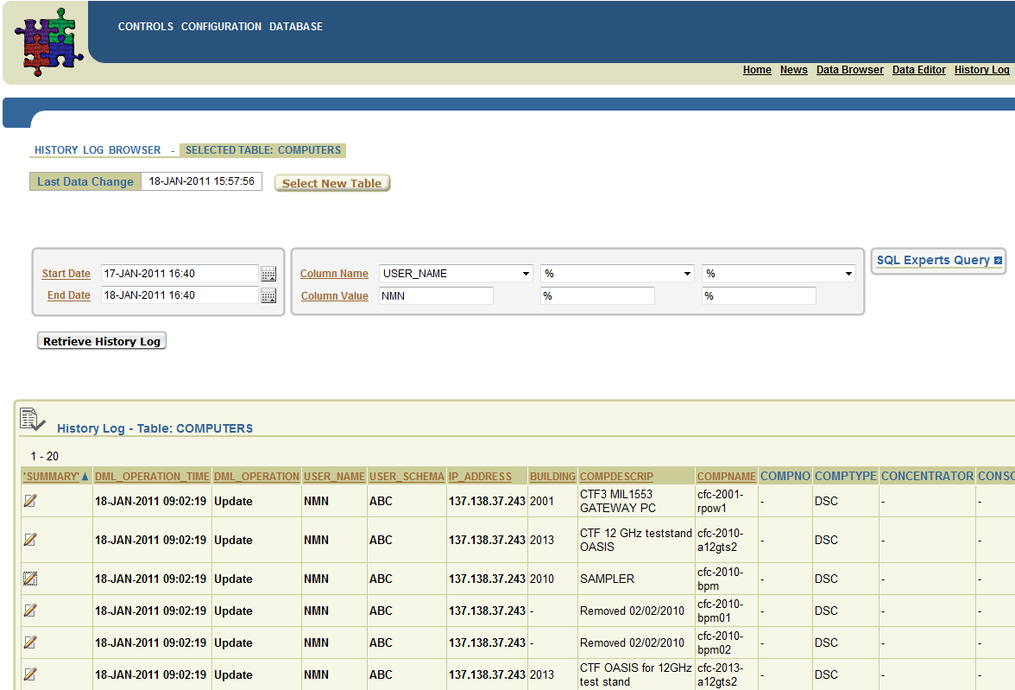
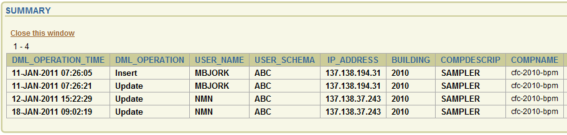
Data Security
Data security is paramount in the Controls Configuration
  Audit of every session opened in the CCDB
    To know: who did what and when
  Tracing data changes
    History framework
    All data modifications are recorded since 2005 and kept on-line
History Log Browser
  gives access to the history logs
  Used a lot by the Controls
  Exploitation team
Notes:
Data security is paramount in the CCDB. The CCDB provides specially developed functionality to audit every session opened in the CCDB, allowing monitoring of who changed what data and when.
In order to trace data changes, a custom history framework was developed. All data modifications are recorded and kept on-line since 2005. There is a special web-deployed application – the CCDB History Browser, which gives access to the history logs. This application is used heavily by the Controls Exploitation team.
The history log also serves as a basis for versioning of the configuration data for each configuration item

Slide 19
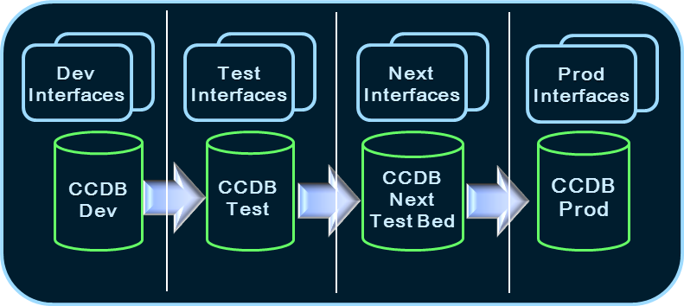
Quality Assurance
Controls Configuration – extremely dynamic environment – has to follow-up all changes in all systems using the service
  New requirements or changes to existing functionality have direct impact on DB, APIs, applications
  A lot of efforts are put into testing and knowing dependencies so that end-clients are not affected by changes in the CC Service
Four environments created for the service - DB, interfaces and APIs
  DEV – any development start here
  TEST – unit and functional testing
  NEXT – integration testing; part of the CO TestBed since 2010
  PROD
Notes:
The Control of CERN’s accelerators is a very dynamic environment with new and changing user requirements coming regularly, directly impacting the database model as well as the different applications and APIs. The best software development style to suit such an environment is agile programming, facilitating fast prototyping and short time to production to achieve a feature complete solution.
Four environments have been provided for the CCDB, its interfaces and APIs – Development, Test – used for unit and functional testing, Next – used for integration testing and Production environments.
The Next environment of the Controls Configuration is part of the Controls TestBed since 2010 [8]. Some changes in the Controls components are so fundamental, e.g. the renovation of the accelerators Timing System in 2011, that it could take more than 1 year before deploying the new functionality to production. The TestBed provides unique opportunities to perform integration and system testing of the new functionalities with all major components of the Controls System being available.

Slide 20
Propagation of Configuration Data
Data management for the Control and Operation of the accelerators is implemented as a distributed database environment
  Part of the data stored in the CCDB is propagated to other database system for the needs of the Operation
    75% of all alarms definitions in LASER are coming from CCDB
    Data for all computers monitored by DIAMON
    Devices and properties data to LSA
Changes to configuration data
could impact related DBs
  Strategy for smooth upgrades of
  the data-driven Controls System
Accelerators settings (LSA)
Logging DB
Controls Configuration DB
TIM DB
DIAMON DB
LASER DB
(Alarms)
LogBook
Notes:
The data management for the Control and Operation of CERN’s accelerators is implemented as a distributed database environment [9]. Part of the data stored in the CCDB is propagated to other database systems for the needs of the Operation of the accelerators (see Fig.2).
The alarm definitions (>120,000) for all accelerators devices, are generated and propagated to the Alarms Database [10]. Part of the devices’ data is propagated towards the Accelerators Settings (LSA) database, where it is used as a basis for the Operation of the accelerators. The CCDB provides the data for the computers (Front-Ends, consoles, servers, etc.), which need to be monitored by the Diagnostics and Monitoring System (DIAMON).
Safe Propagation of Data Changes
Changes to configuration data in CCDB could have an impact on the related databases. A strategy for smooth data upgrades of the data-driven Controls System has been established with the objective to ensure a coherent set of data throughout all distributed databases. Database procedures are developed in the CCDB to safely propagate data changes, based on knowing the data dependencies between the different systems. The impact of the configuration data changes is analyzed and appropriate actions taken – this process is part of the configuration Change Management functionality provided by the CCDB.

Slide 21
Conclusion
Controls Configuration DB, related interfaces and APIs and implemented processes form the basis for the Configuration Management of the Controls System
Ensures conceptual unification and centralization of the diverse configurations as well as describing the dependencies between the components
Continuous effort into rationalizing, improving, federating and developing new functionalities with a constant focus on Quality Assurance and Data Security
Involvement of the Controls Configuration into diverse projects as a service providers and following all new developments and upgrades related to the Controls System components
  ACCOR, ACET, BIS, CCM, CMW, Diamon, Drivers, FESA, LASER, LSA (InCA), Oasis, QPS, Power Converters, PVSS and PLCs, SMP, Vacuum controls, etc.

Slide 22





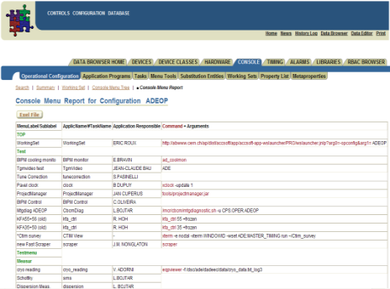
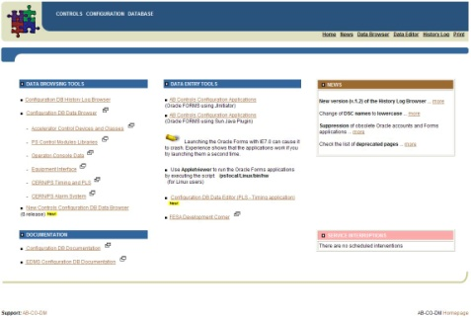

Questions
Thank you for your attention!

Slide 23
