Slide 1
Parallel beam execution in FAIR:
control system concepts and requiements for FESA
J.Fitzek
FESA Workshop, 27. Nov. 2012, GSI

Slide 2
Agenda
Operation of the FAIR facility
Timing information within the Control System
Requirements for FESA

Slide 3
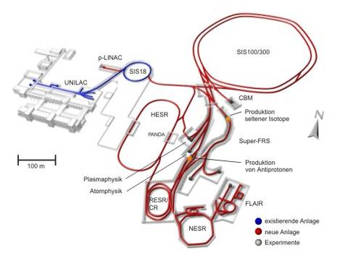
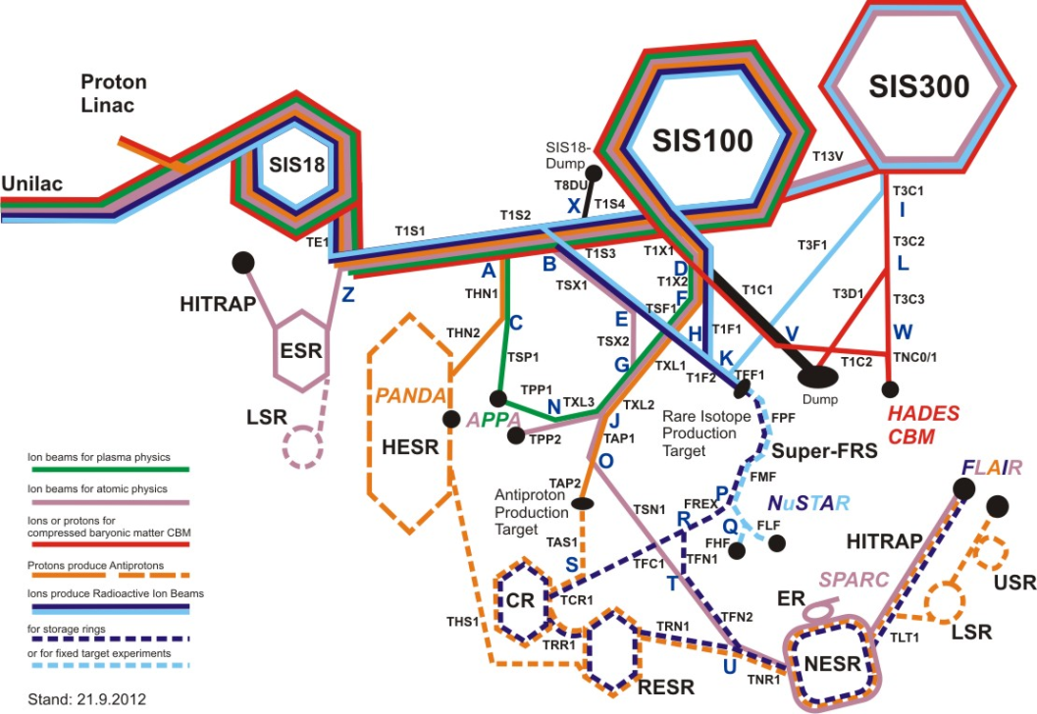
FAIR facility
© Petra Schütt, GSI, 2012

Slide 4
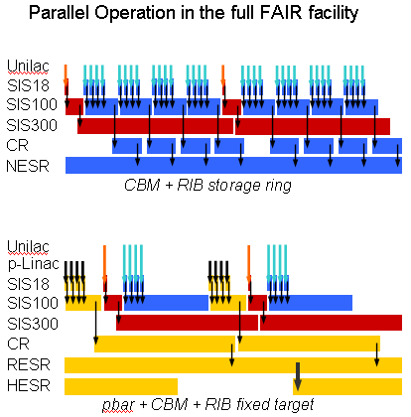
Operation of the FAIR facility
up to 5 parallel beams
optimize the duty-cycle
support alternatives
and dump scenarios
focus on planning of „beams“
typically one main experiment per pattern , that defines the time frame, other experiments fill the gap
no fixed pattern length, length vary with setting changes (e.g. energy)
during daily operations, patterns are being activated / (re-)organized
© David Ondreka, MAC Presentation, Oct. 2011

Slide 5

Terminology
Pattern
Supercycle
Beam Production Chain

Slide 6
Example for two active patterns
Pattern 1: Protons and RIB, executed indefinitely
Pattern 2: Plasma Physics, executed once every two hours
when experiment requests the beam
Unilac
p-Linac
SIS18
SIS100
CR
Pre-Pattern
Main-Pattern
Post-Pattern
Unilac
SIS18
SIS100
PP
Pre-Pattern
Main-Pattern
Post-Pattern
Notes:
Zweites Pattern weil selten, soll im Normalbetrieb nicht drin sein, duty cycle Optimierung => neue Patterns immer dann, wenn unabhängig
Generell Patterns: Vorbereitung : Hauptteil : Nachbereitung
Patterns aktiv / nicht aktiv: es können als Vorbereitung zusätzliche, nicht aktive Patterns eingerichtet werden.

Slide 7
Contents of beam production chains
BPC 1
BPC 2
further grouping?
SIS18
Inj
Rampe
Ext
Beam-out
Inj
Rampe
Ext
Beam-out
T1S1..T1S4
Beam-Out
Tfr
Beam-out
Tfr
Beam-out
SIS100
Inj
Rampe
E
Beam-out
Inj
Rampe
Extraktion

Slide 8
Agenda
Operation of the FAIR facility
Timing information within the Control System
Requirements for FESA

Slide 9
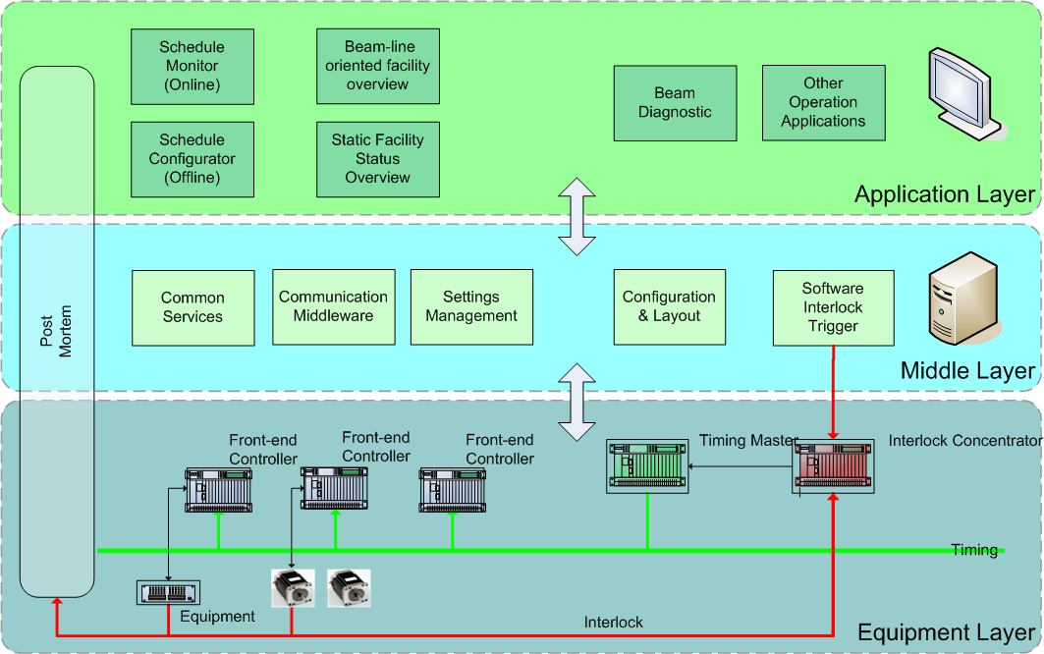
FAIR Control System stack

Slide 10



Planning of synchronized executions
Settings Management (LSA)
Data supply:
set values (with IDs)
Data supply:
schedules of IDs,
alternatives
time sync,
ID@time
RT-control

Slide 11
Timing System from an outside perspective
The timing system:
one central timing master, sends out events for the full facility
(filtering on the timing receiver side)
„executes“ BeamProcesses
assumption: BPs are the smallest pieces that are always executed completely
always sends out the full event, that contains:
  all necessary IDs
  a timestamp to make the execution unique
  event number to describe actions in the accelerator

Slide 12
Agenda
Operation of the FAIR facility
Timing information within the Control System
Requirements for FESA

Slide 13
Requirements for FESA
In general, FESA must be able to handle the indexing needed for the execution of patterns and chains.
Requirements that arise are:
FESA must allow the indexing of set values with the corresponding IDs
  implementation of the multiplexing context accordingly
  => similar concept needed for the upper layers too (JAPC, LSA)
  mapping of IDs to memory location?
FESA must be able to put the full „event stamp“ to actual values
  if available, the full event stamp must be provided to the user
  allow for partial compare if user requests for all actual values of one BPC execution?

