Slide 1
Data consistency & data store
FESA Advanced

Slide 2
Agenda
Problems with previous framework
More problems with the new CPUs
FESA 3 solutions
Fields types
Field type decision trees

Slide 3
Typical priorities
we typically give a lower prio to the server threads
E.g. RT around 50 and server around 25
Sometimes, we give even lower prio for some properties (FESA 2.10 background props)

Slide 4
Settings problem
Datastore
Inconsistent
Server writes
new settings
✓
The RT uses consistent settings
set
RT writes
settings in HW
Datastore
Inconsistent
✗
The RT uses inconsistent settings
Server writes
new settings
set
RT writes
settings in HW

Slide 5
Acquisition problem
Datastore
Server updates
clients
✓
The server sends consistent data
RT writes
acquisition
Datastore
Inconsistent
Server updates
clients
✗
The server sends inconsistent data
RT writes
acquisition

Slide 6
Agenda
Problems with previous framework
More problems with the new CPUs
FESA 3 solutions
Fields types
Field type decision trees

Slide 7
New CPU New problems
Intel Core 2 DUO L7400 – 2 cores w/o hyperthreading
2 cores ➔ 2 threads run in parallel whatever the prio
Datastore
Inconsistent
Inconsistent
✗
The RT uses inconsistent settings
Server writes
new settings
set
RT writes
settings in HW
Similar problem for the acquisition case
Playing with prio no longer helps with data races

Slide 8
Agenda
Problems with previous framework
More problems with the new CPUs
FESA 3 solutions
Fields types
Field type decision trees

Slide 9
FESA 3 solutions Settings
Settings flow as defined in FESA 3 is
High-level → Server part → RT part → Hardware
Double-buffer mechanism to protect against data races
Inconsistent
RT sync
pending buffer (server)
Datastore
active buffer (RT)
OK
OK
Server writes
new settings
The RT uses consistent settings
set
✓
RT writes
settings in HW
RT sync done in the RT part
Very cheap pointer swapping ➔ very little jitter introduced

Slide 10
FESA 3 solutions Acquisition
Acquisition flow as defined in FESA 3 is
Hardware → RT part → Server part → High-level
Rolling-buffer mechanism to protect against data races
Discards
data
for X
Datastore
Z
Cystamp Y
Server updates
clients
Data for cystamp X
The clients receive consistent acquisitions
Updates for X
✓
RT writes
acquisition
Uses the cycle-stamp to select the buffer
Implementation hidden → you don’t have access to the other buffers

Slide 11
Agenda
Problems with previous framework
More problems with the new CPUs
FESA 3 solutions
Fields types
Field type decision trees

Slide 12
Field types
There are 5 types of fields
Configuration
Setting
Unshared setting
Acquisition
Generic
Configuration field
Read-only from anywhere
Default field in the configuration section

Slide 13
Field types
Setting field
Shared and data-consistent (double-buffer)
Read-write from server
Read-only from RT
Default field in the setting section
Buffer swap by RT part
Unshared setting field
Not visible from RT
Setting field’s attribute “shared” = false

Slide 14
Field types
Acquisition field
Shared and data-consistent (rolling-buffer)
Read-only from server
Read-write from RT
Default field in the acquisition section
Works with the cycle-stamp in the context
Generic field
Accessible from anywhere and without any protection
Any field’s attribute “data-consistent” = false
Should be used for private fields only

Slide 15
An example
6 fields – all int32_t
1 configuration field – configField
3 setting fields
serverField – a server only field (i.e. not shared)
sharedField – a double-buffer field
unprotectedField – a generic field w/o protection
2 acquisition fields
rollingField – a rolling-buffer field
rtField – a generic field w/o protection (RT use only)

Slide 16
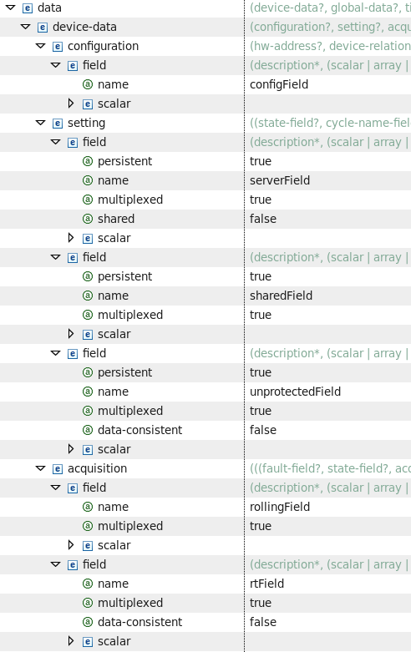
An example Design

Slide 17
An example device.h
class Device : public fesa::AbstractDevice
{
public:
Device();
ConfigFieldScalar<int32_t> configField;
SettingFieldScalar<int32_t> serverField;
SettingFieldScalar<int32_t> sharedField;
GenericFieldScalar<int32_t> unprotectedField;
AcqFieldScalar<int32_t> rollingField;
GenericFieldScalar<int32_t> rtField;
};

Slide 18
An example Device constructor
Device::Device() :
configField("configField",this),
serverField("serverField",true, false, this, true, false),
sharedField("sharedField",true, false, this, true, true),
unprotectedField("unprotectedField",true, this, true),
rollingField("rollingField",true, this, false),
rtField("rtField",true, this, false)
{
}
Note: double-buffer fields and unshared fields have same impl. Only the last arg is different

Slide 19
Rolling buffer depth configuration
Rolling buffer’s size in the instantiation file
Minimum 3 slots
Maximum deps on the FEC memory

Slide 20
Agenda
Problems with previous framework
More problems with the new CPUs
FESA 3 solutions
Fields types
Field type decision trees

Slide 21
Which setting field?
N
Do I need to access the field from the RT part?
Y
Setting field with @shared=false
N
Do I need to write into the field from the RT part?
Y
Setting field with default values
N
Is the field private to the RT part?
Y
ǃ
You must provide your own data protection mechanism
Setting field with @data-consistent=false
Setting field with @data-consistent=false

Slide 22
Which acquisition field?
Y
Is the field private to the RT part?
N
Acquisition field with @data-consistent=false
Y
Do I need to keep the value from the previous execution?
N
2 separate fields:
1 private & 1 w/o history
Acquisition field with default values
start over for each field

